Slide 1
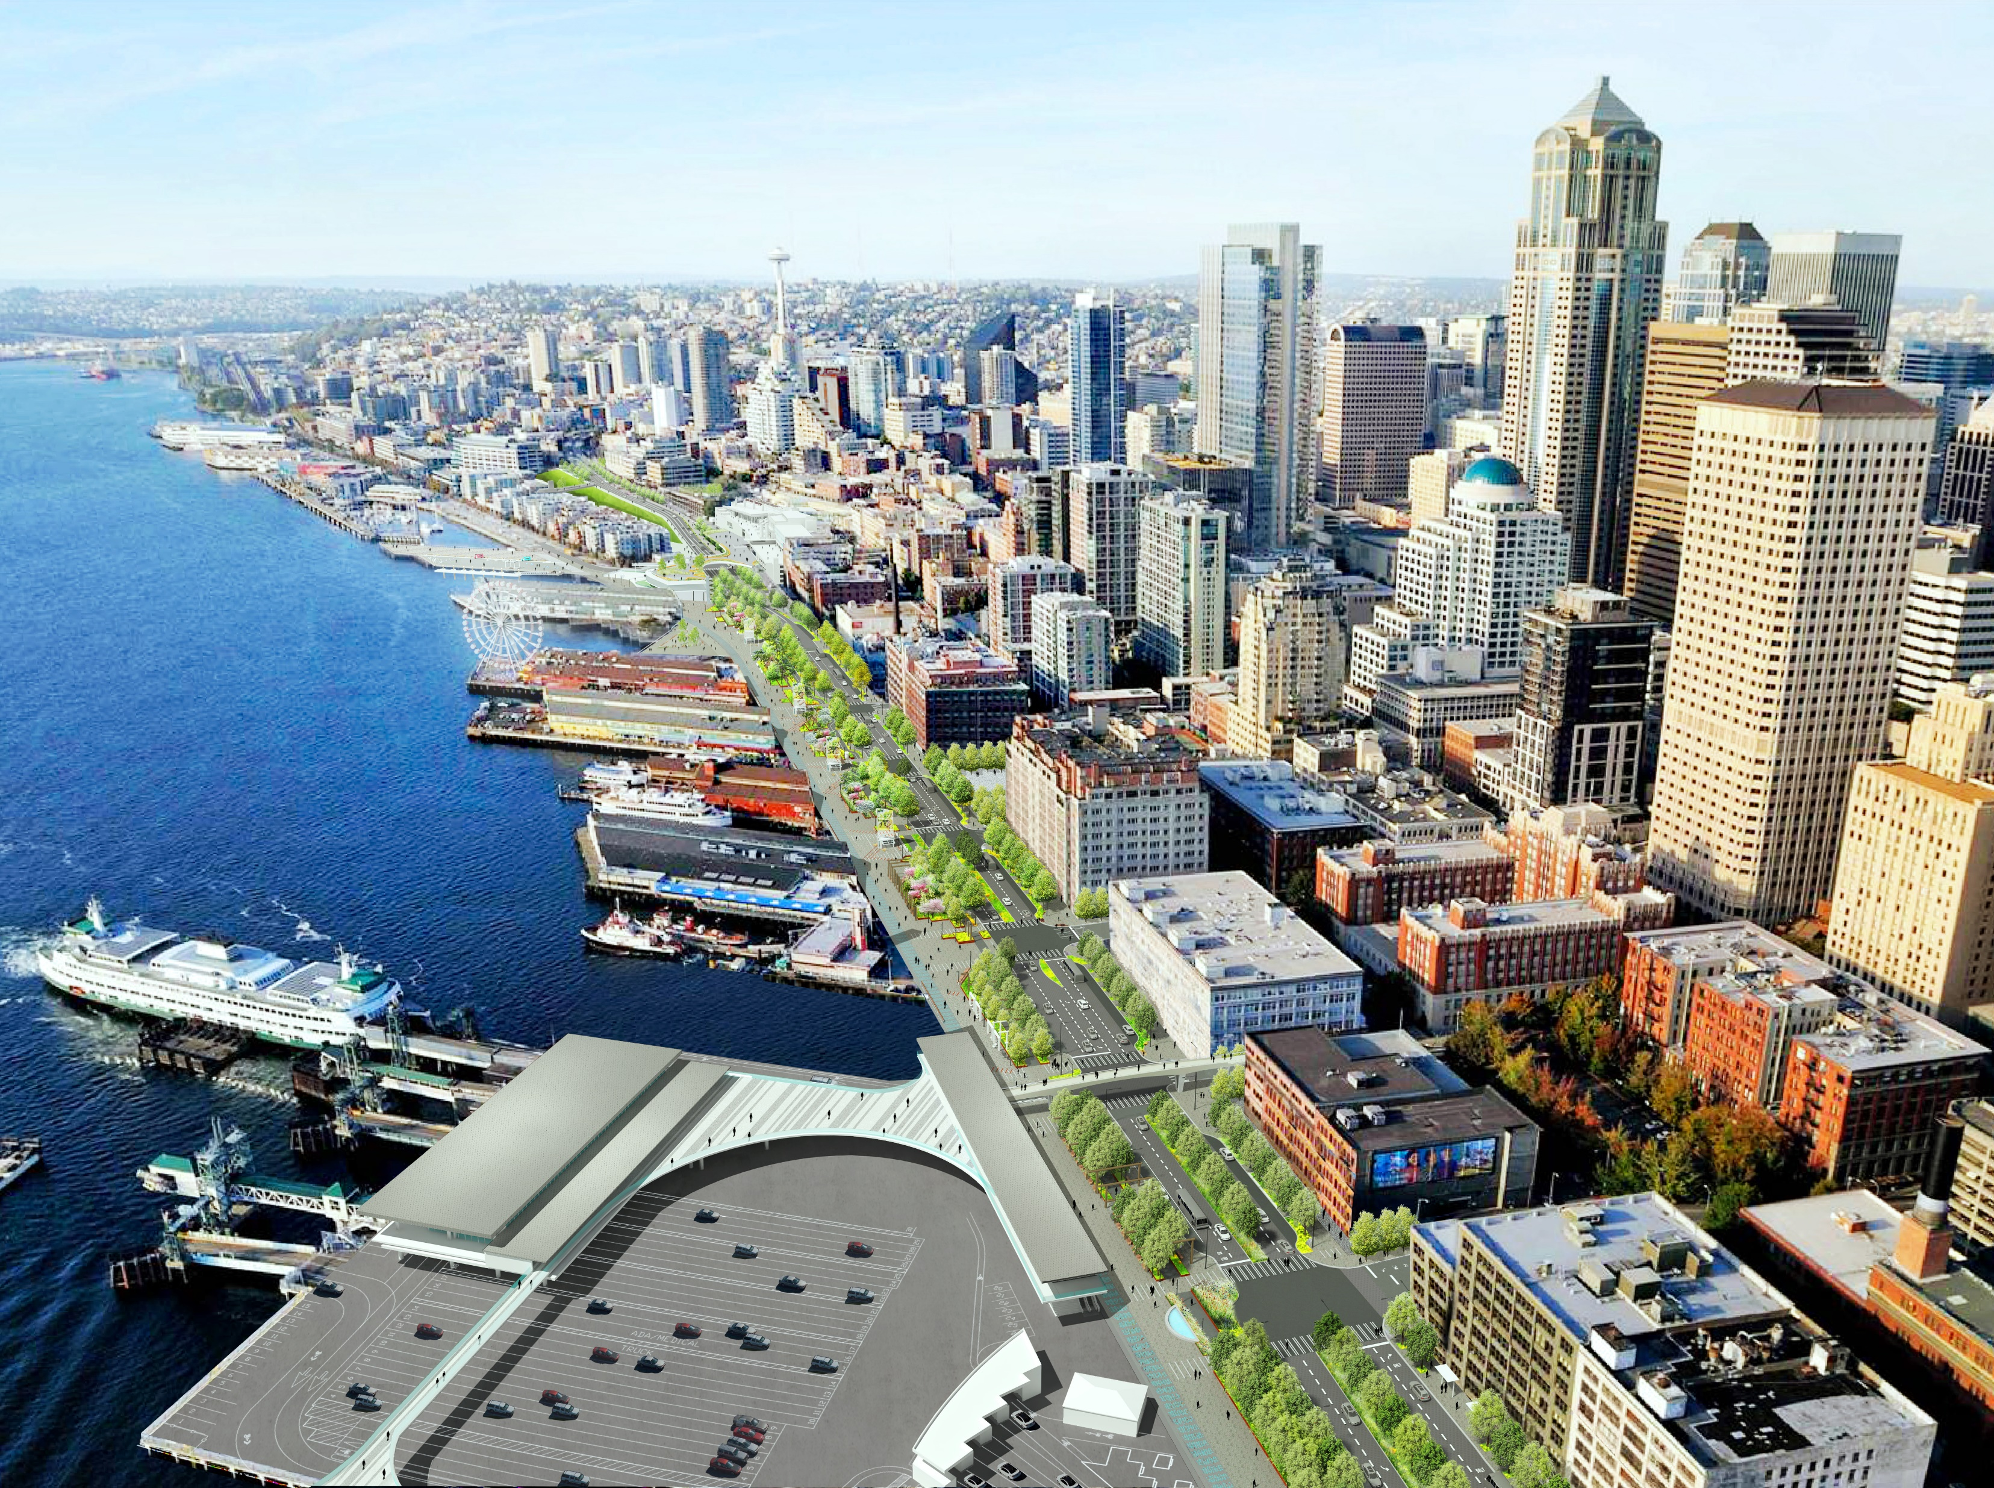
WATERFRONT SEATTLE:
SF CHAMBER SEPTEMBER 2019

Slide 2
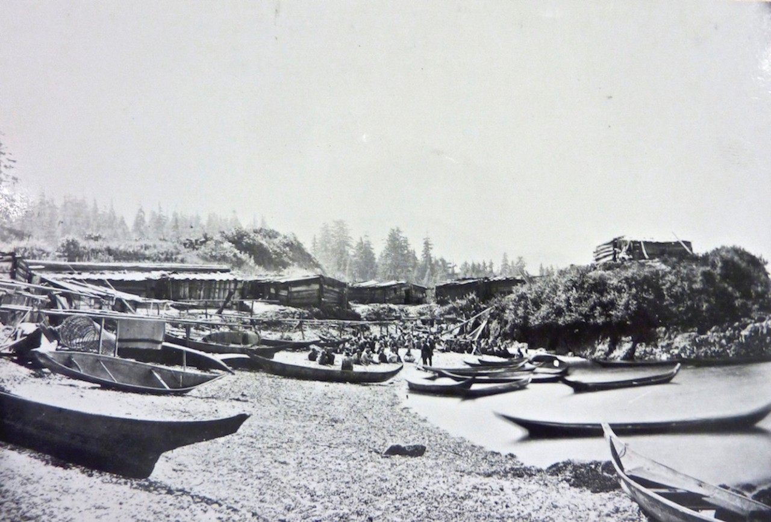

Slide 3
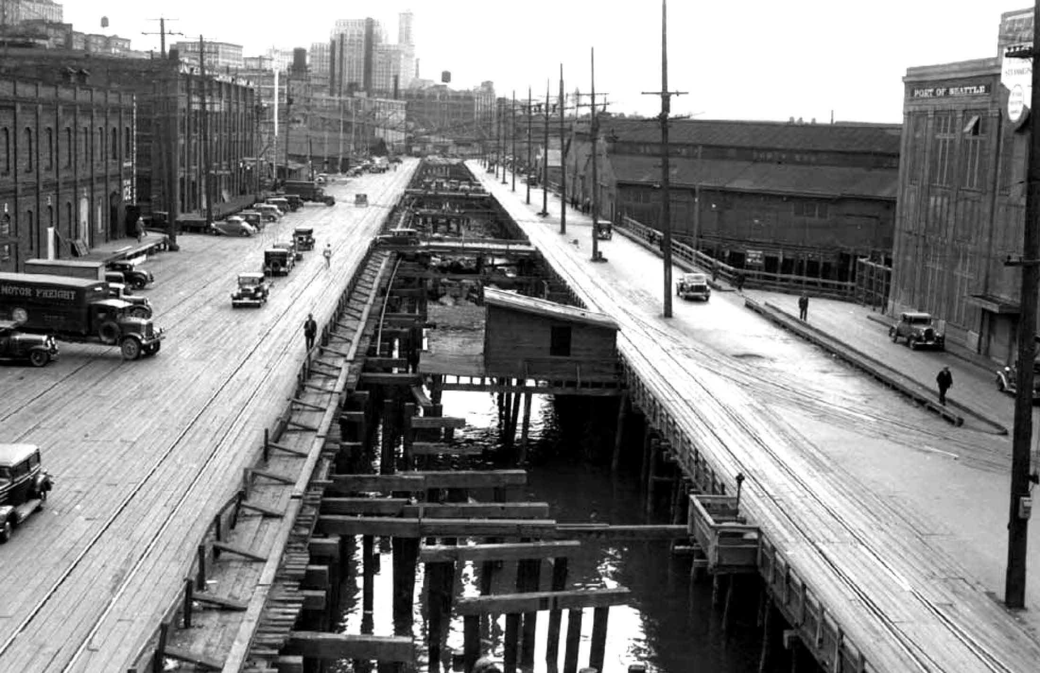

Slide 4
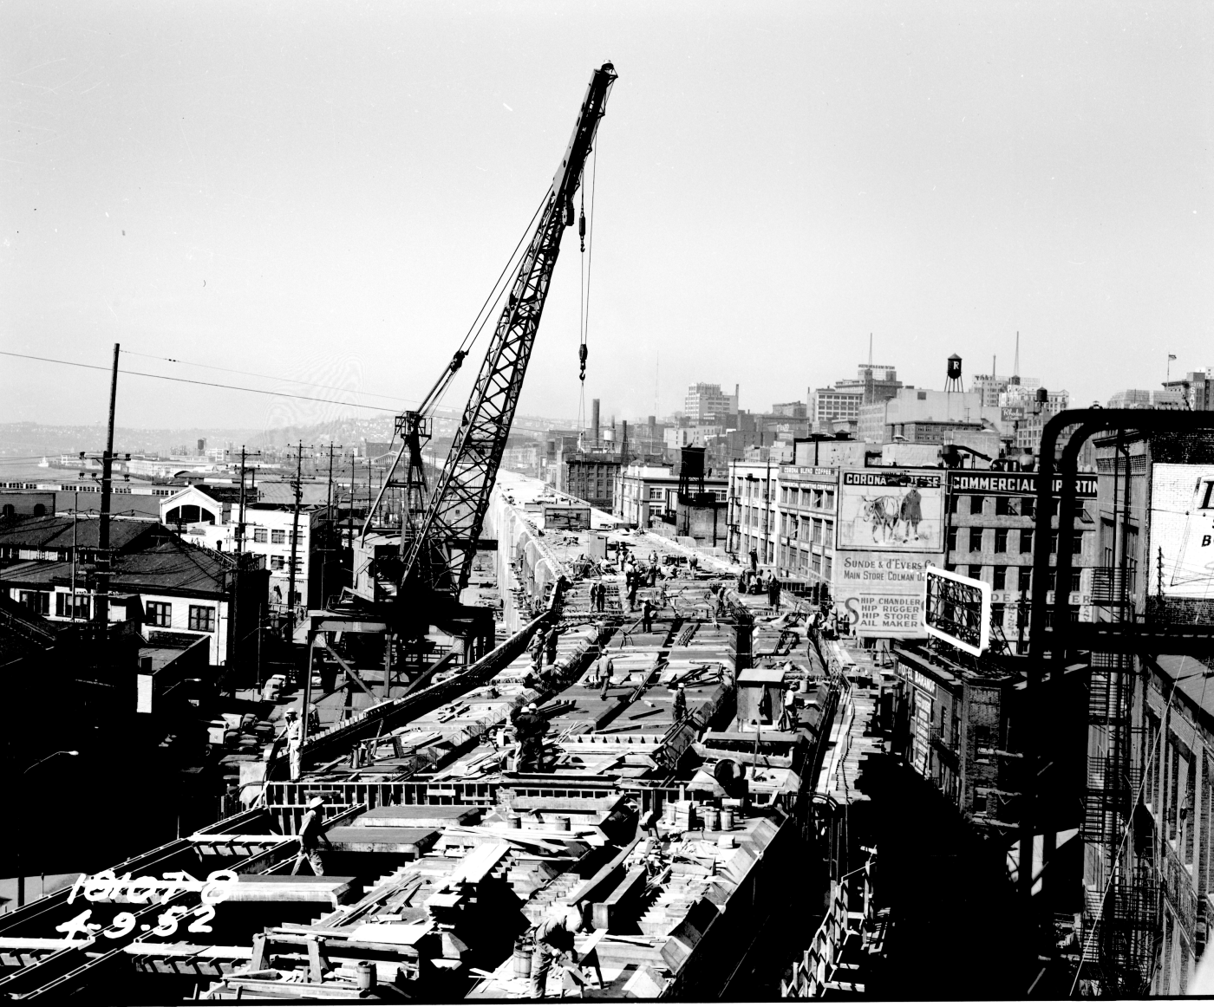
Notes:
…and bringing back opportunities for events and gatherings, for arts and culture.

Slide 5
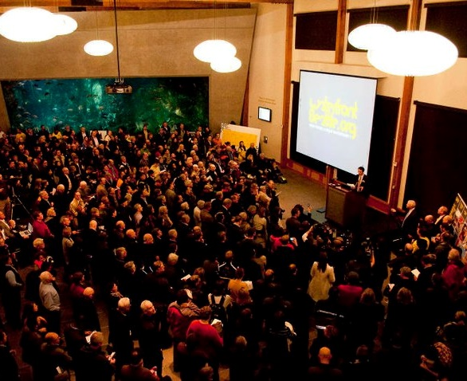
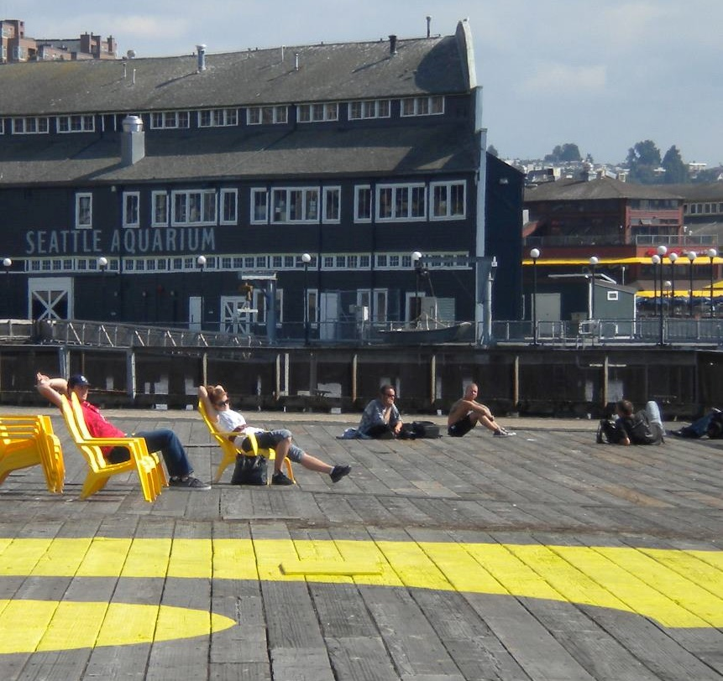
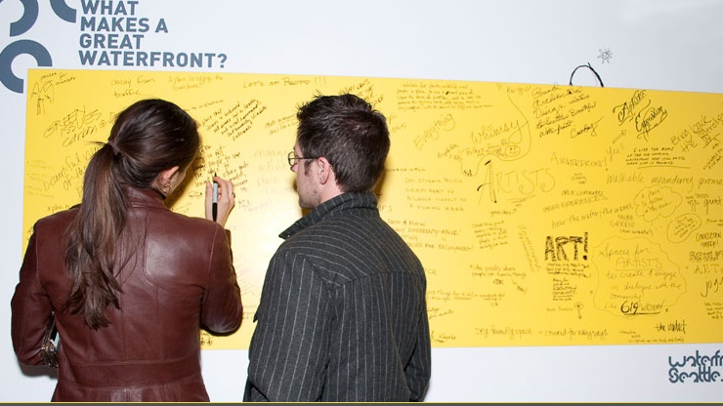
“WATERFRONT FOR ALL”
Notes:
Describe how community input shaped the planning and design process:
Since 2010, more than 10,000 people contributed comments and ideas at hundreds of events and activities, including walking tours, large-scale public meetings, community workshops, and local fairs and farmers markets.

Slide 6
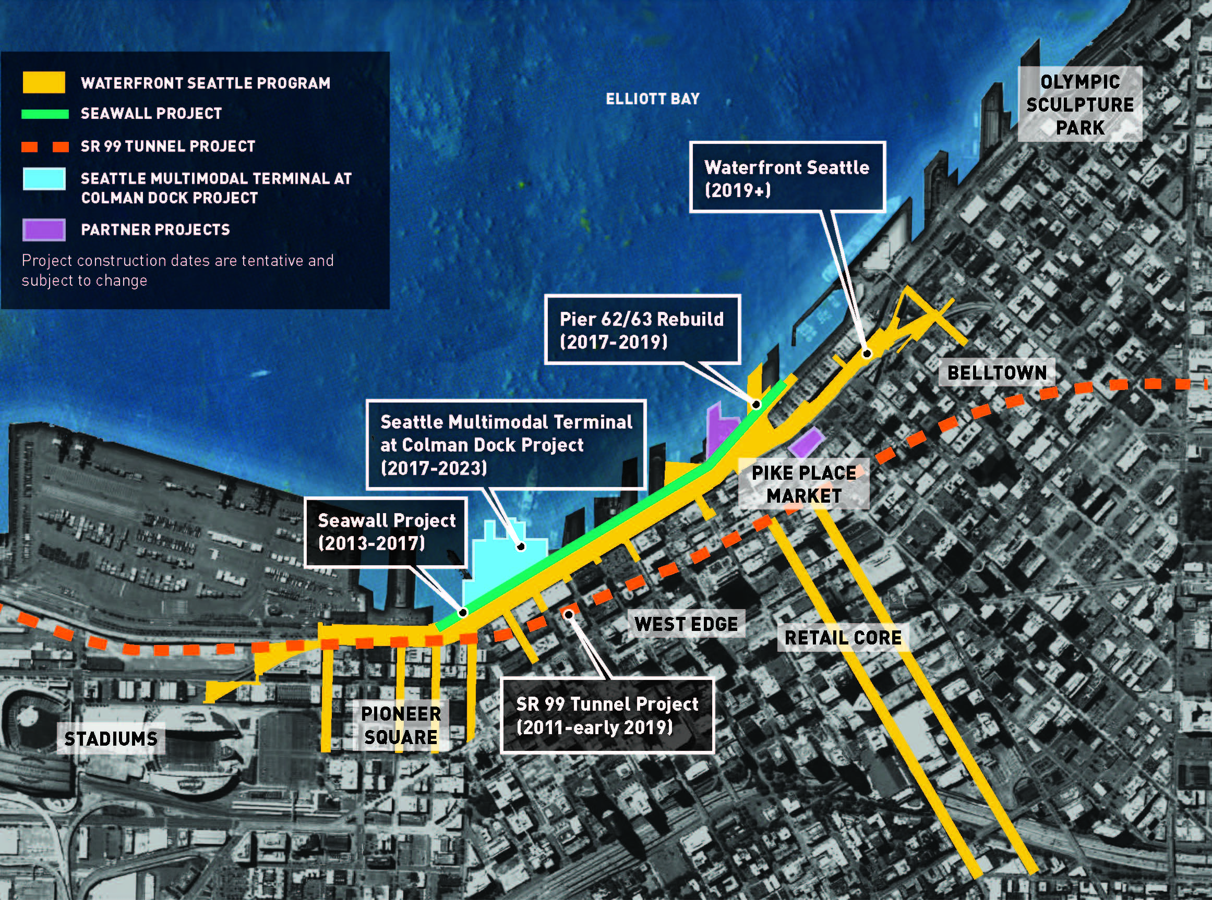
Notes:
The waterfront is about to change in many ways – this map shows all the different projects that are happening along Seattle’s waterfront, including a new seawall, rebuilt ferry terminal, and expansions at the Seattle Aquarium and Pike Place Market.
Due to all these changes coming to our waterfront, we have an unprecedented opportunity to create new public spaces and a true waterfront for all.
Discuss difference between Waterfront Seattle (City); AWV/Colman Dock (State); Seawall (SDOT).

Slide 7
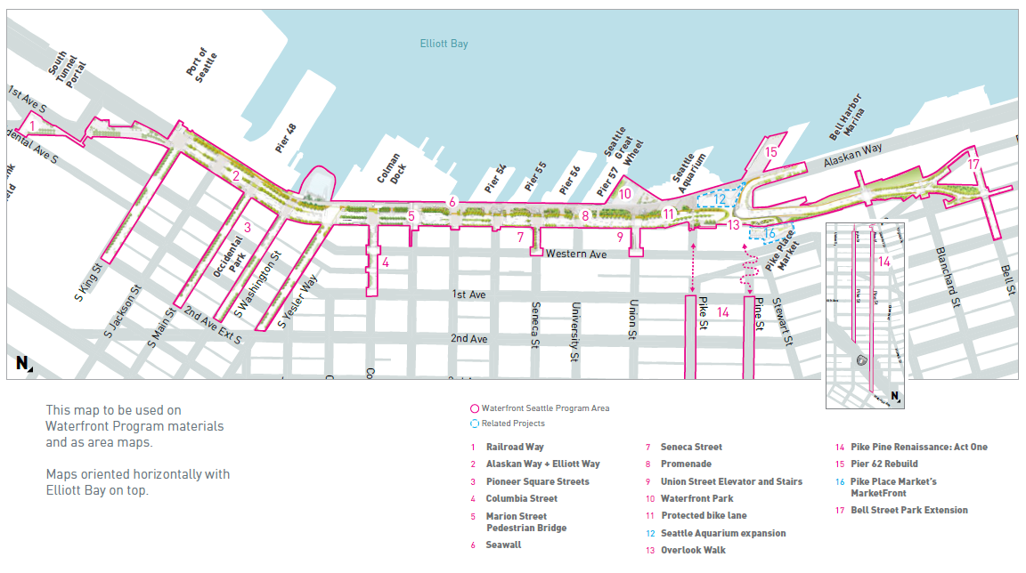
WATERFRONT SEATTLE PROGRAM
6

Slide 8
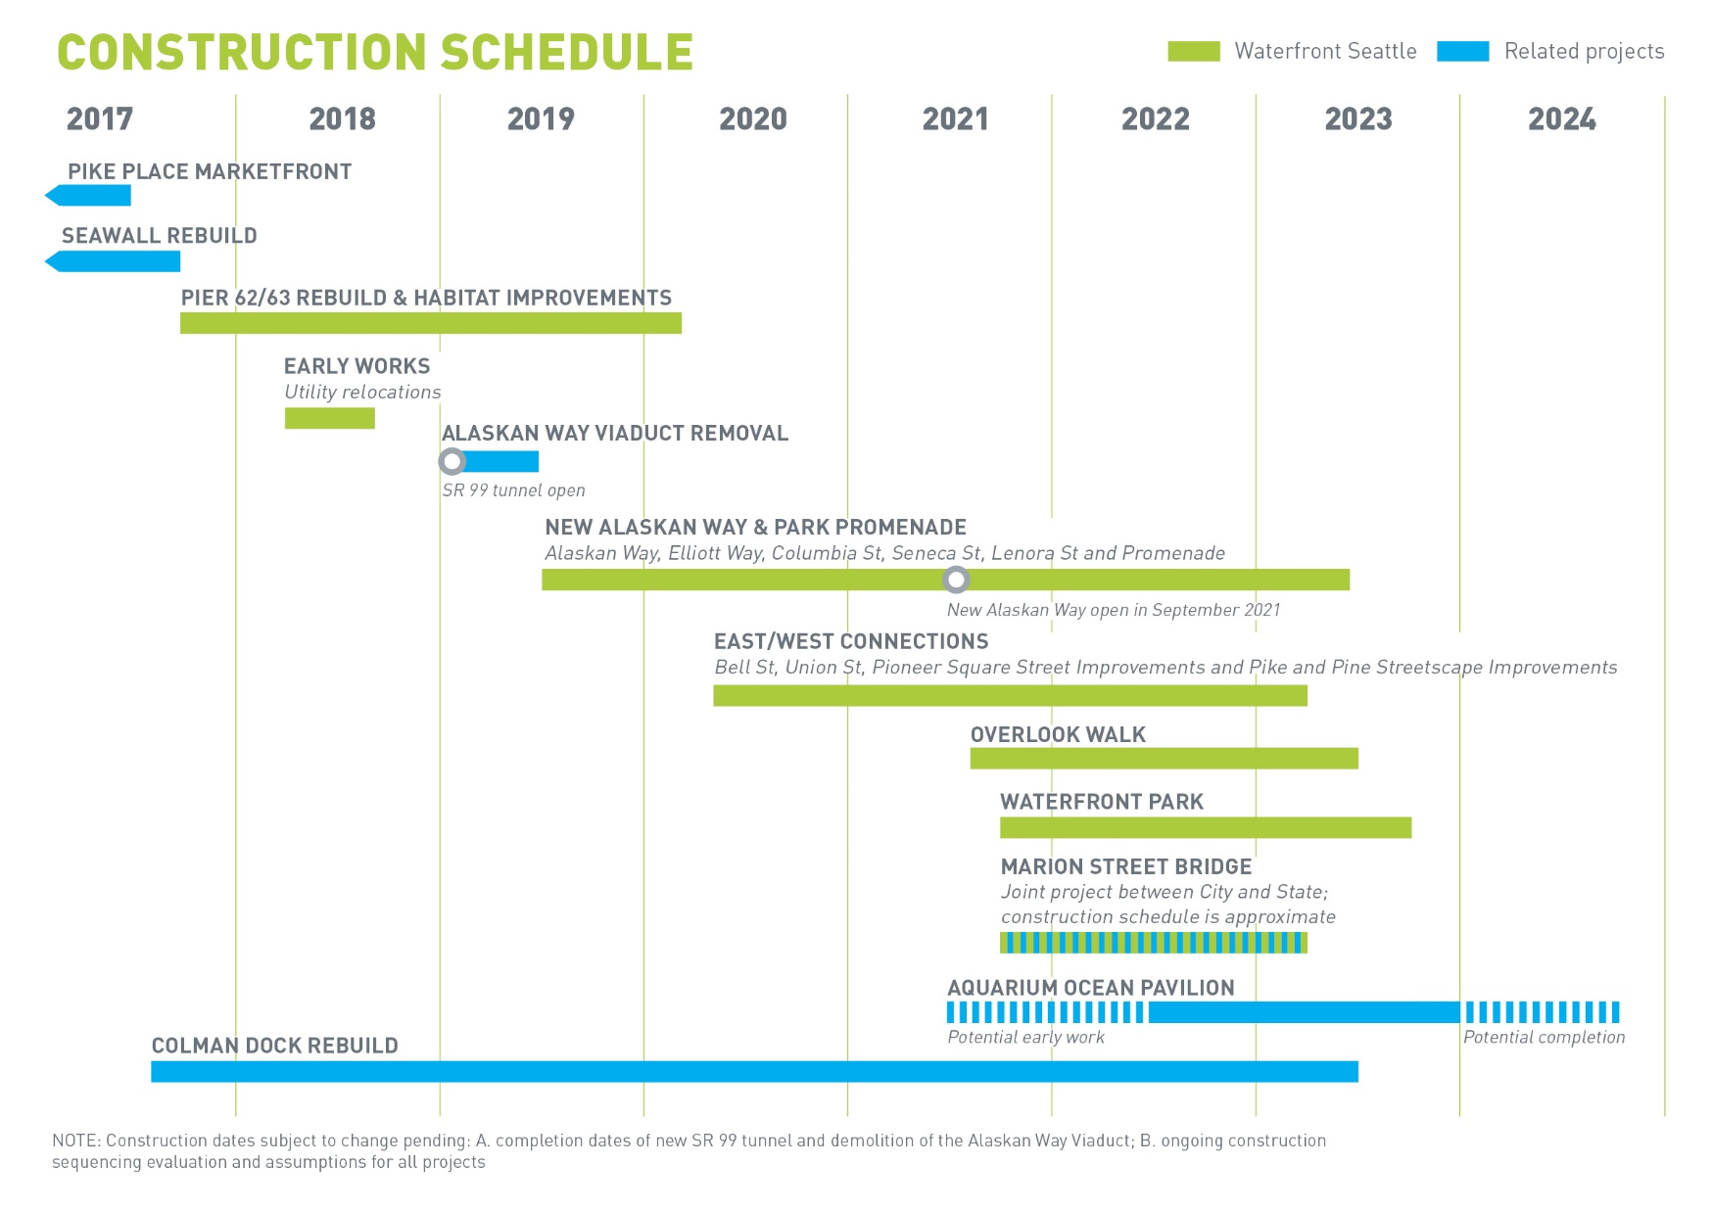
SCHEDULE
Notes:
Review current schedule, at a high level

Slide 9
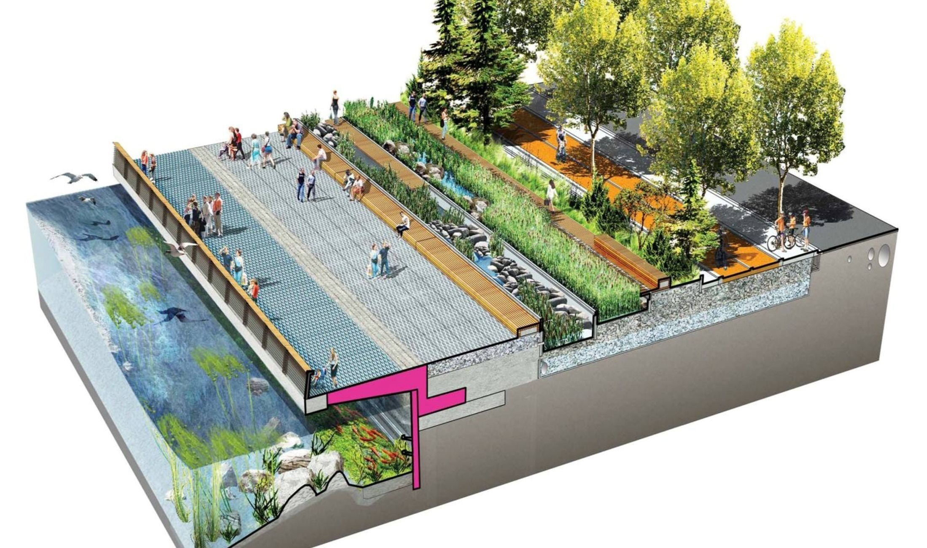
SEAWALL AND PROMENADE

Slide 10
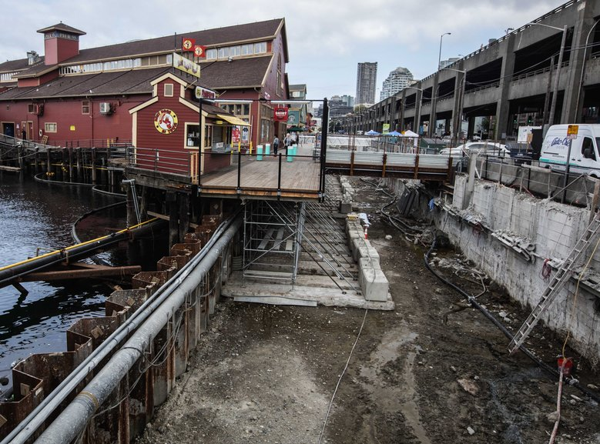

Slide 11
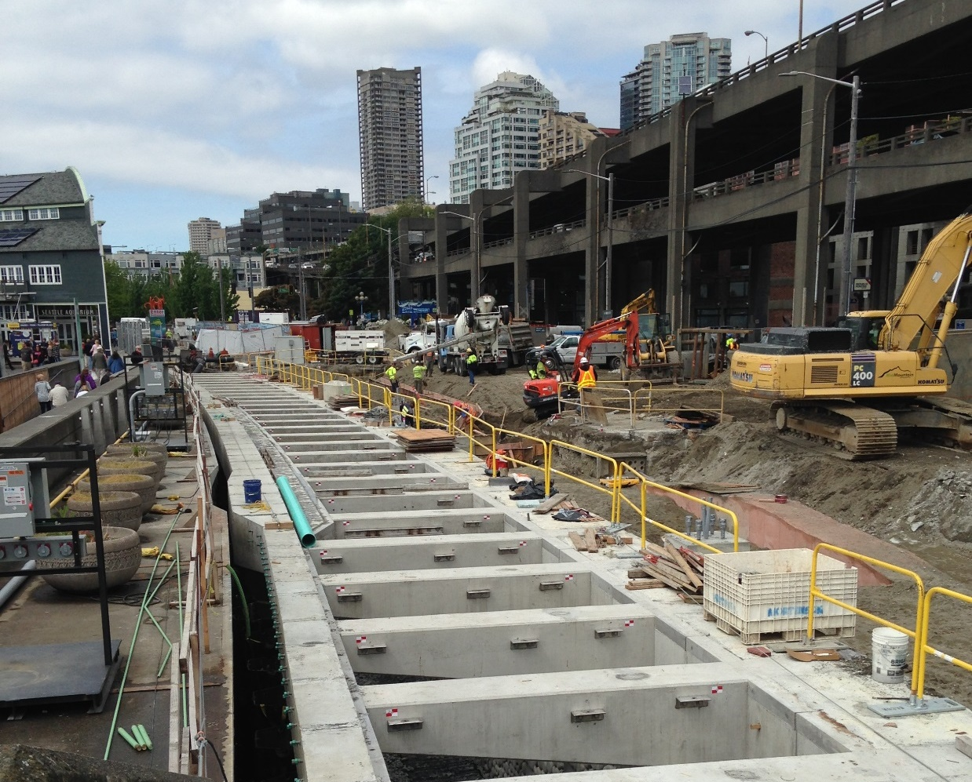

Slide 12
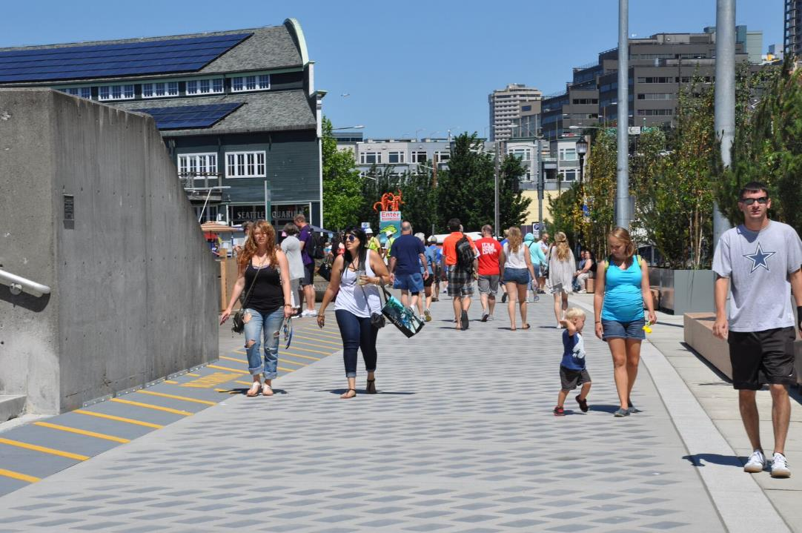
Notes:
Portions of the light penetrating sidewalk panels area already installed, as you may have seen if you’ve visited the waterfront recently.

Slide 13
Notes:
Portions of the light penetrating sidewalk panels area already installed, as you may have seen if you’ve visited the waterfront recently.

Slide 14
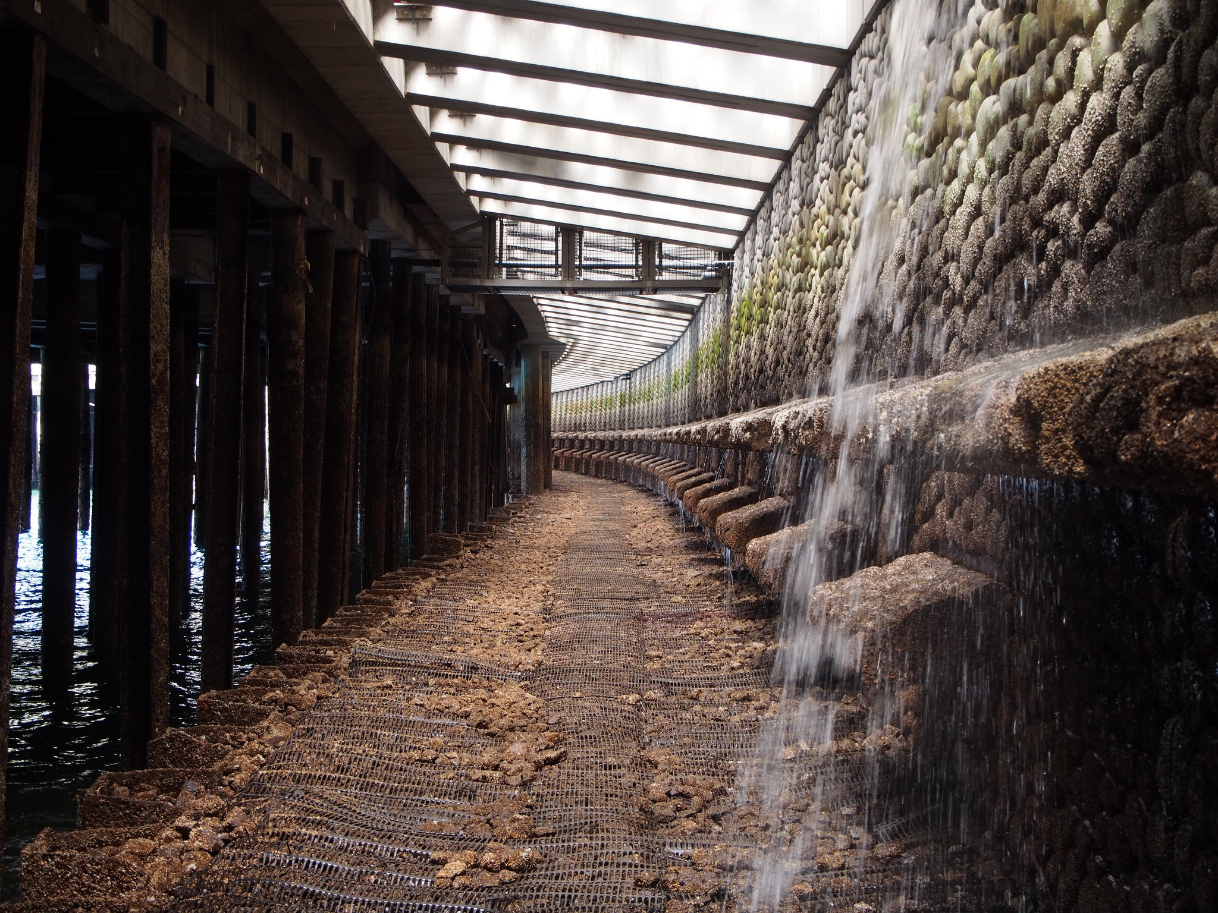
NEW SEAWALL
Notes:
Detail of Seawall construction Z panels

Slide 15
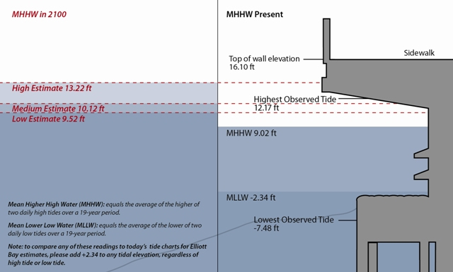
SEA LEVEL RISE – 2100 PROJECTION
TYPICAL SECTION: SEAWALL, HABITAT SHELF + L.P.S.

Slide 16
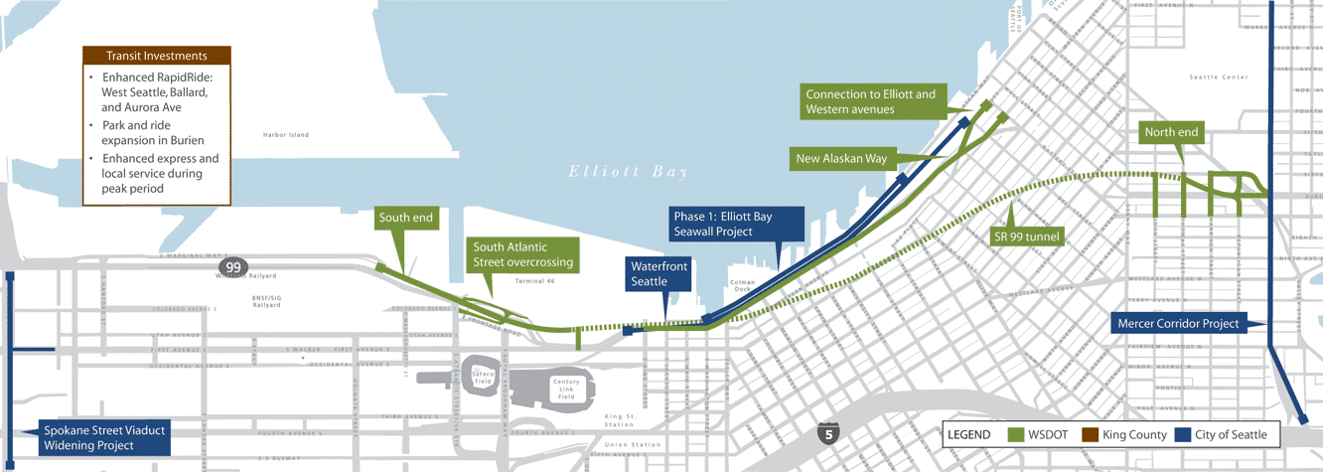
INFRASTRUCTURE PARTNERSHIP

Slide 17
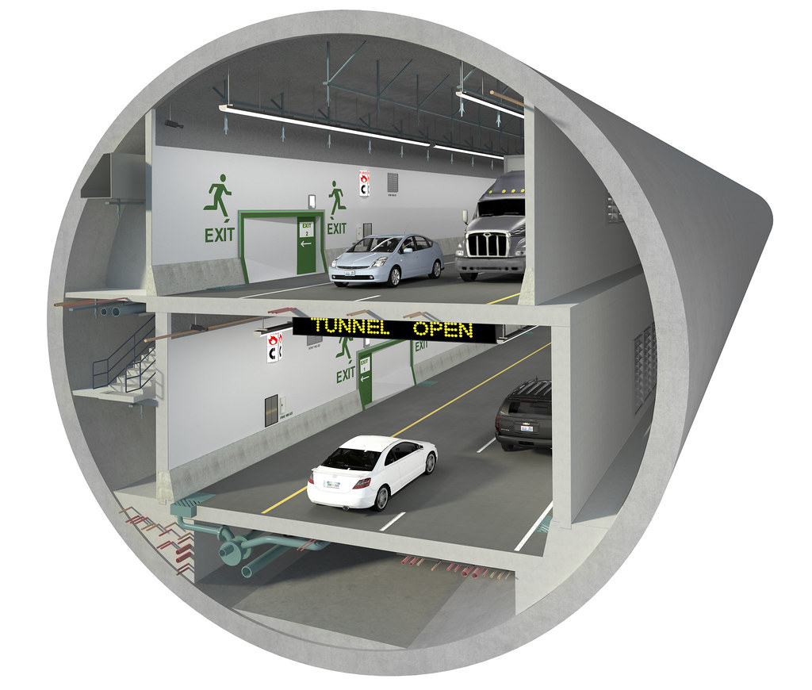

Slide 18
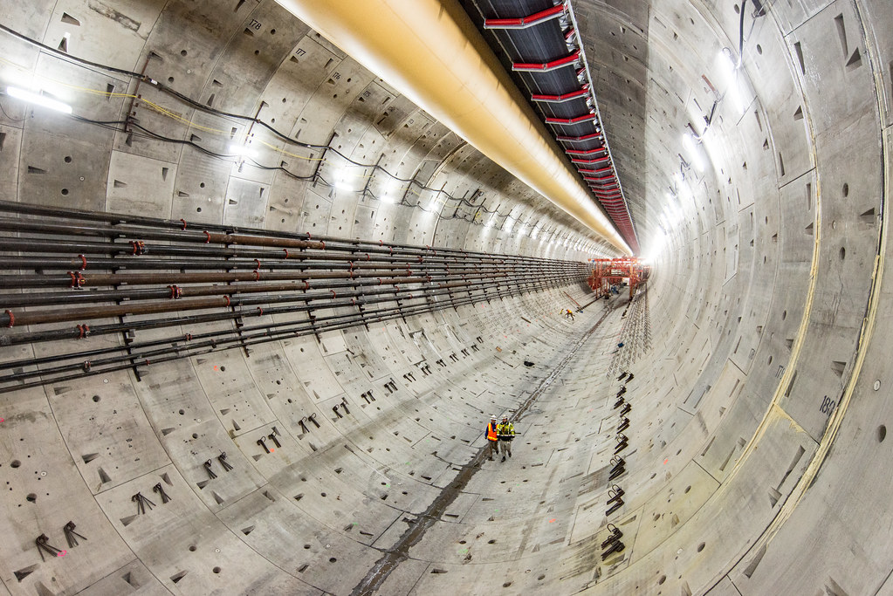

Slide 19
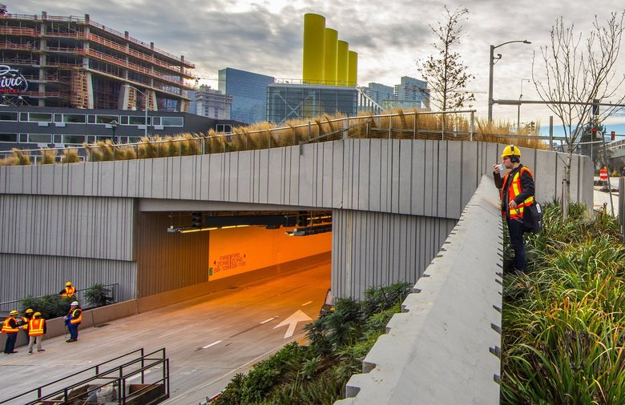

Slide 20
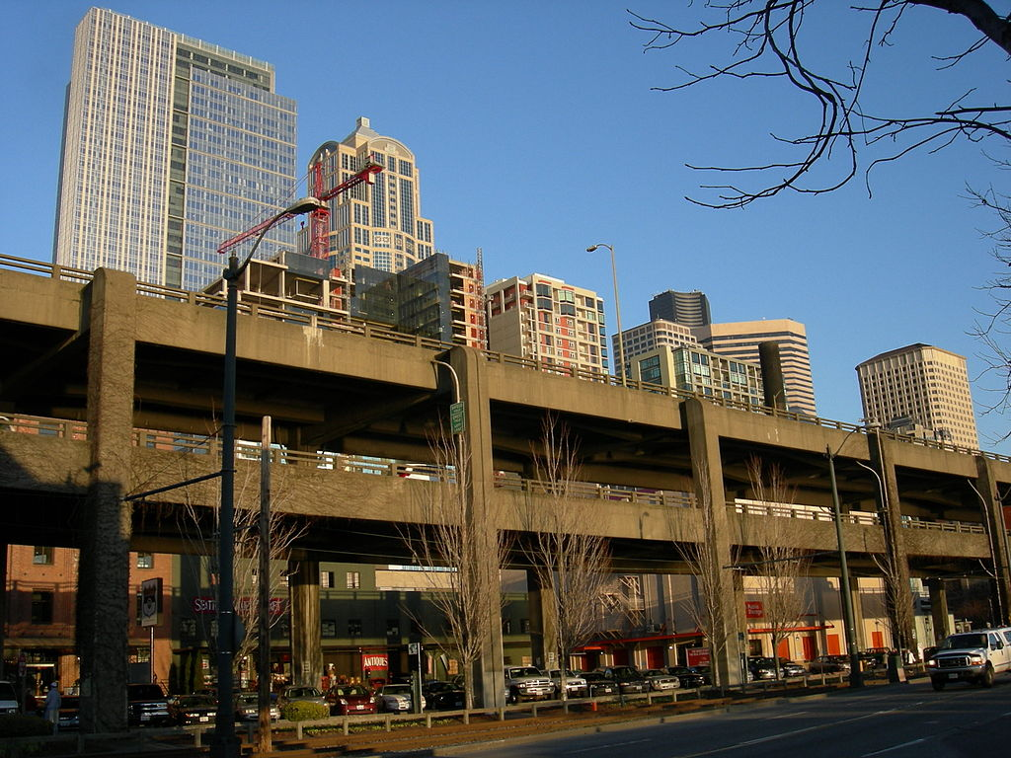
Image courtesy of One Reel

Slide 21
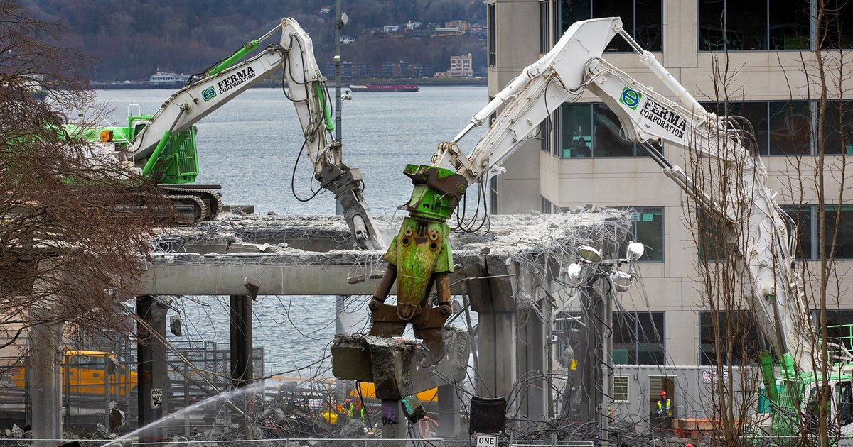

Slide 22
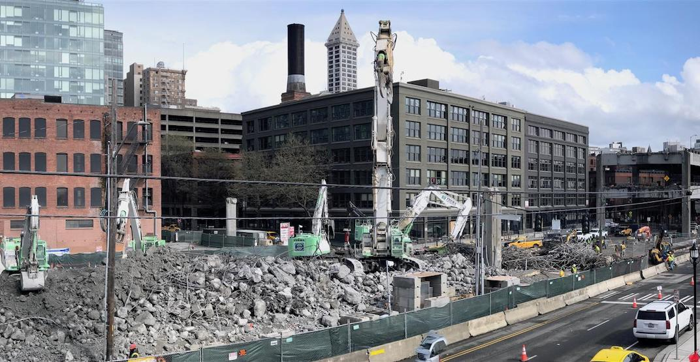

Slide 23
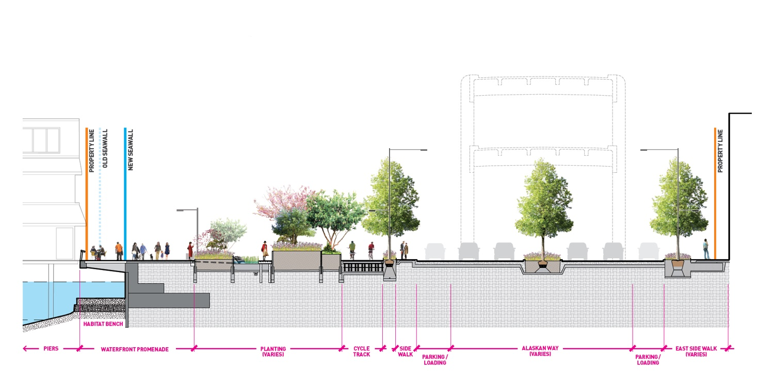
THE NEW WATERFRONT

Slide 24
ALASKAN WAY
Notes:
Program supports multi-modal transportation choices and has a people-first approach, including:
1.3 dedicated miles of bike path
Signalized intersections for safer and more comfortable pedestrian crossings
The new surface street will serve transit, freight, and general traffic
pedestrian promenade

Slide 25
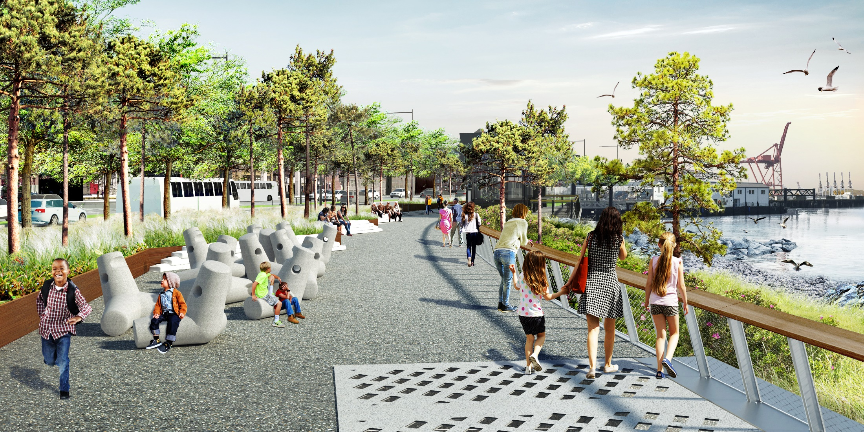
PIONEER SQUARE BEACH
Notes:
Program supports multi-modal transportation choices and has a people-first approach, including:
1.3 dedicated miles of bike path
Signalized intersections for safer and more comfortable pedestrian crossings
The new surface street will serve transit, freight, and general traffic
pedestrian promenade

Slide 26
Colman Dock
Alaskan Way
Marion
Madison
Spring
University
Seneca
26

Slide 27
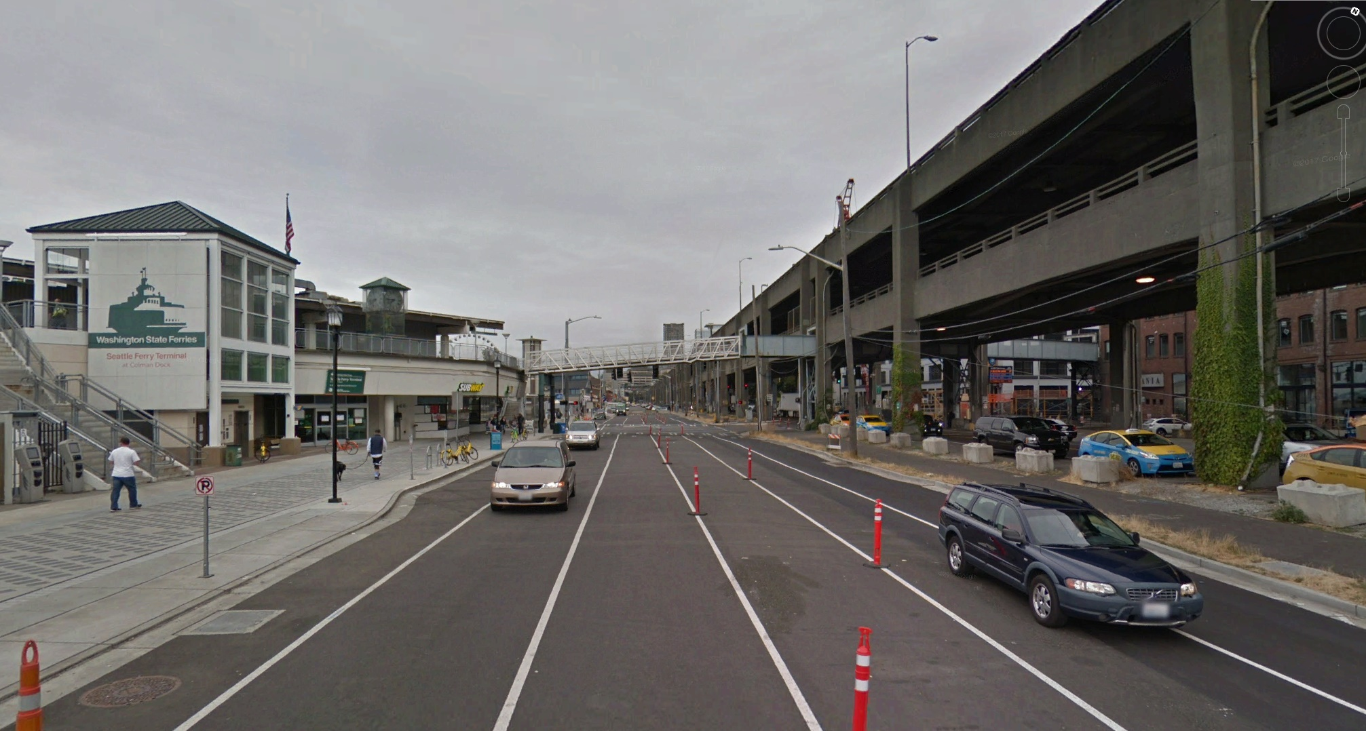
COLMAN DOCK TODAY

Slide 28
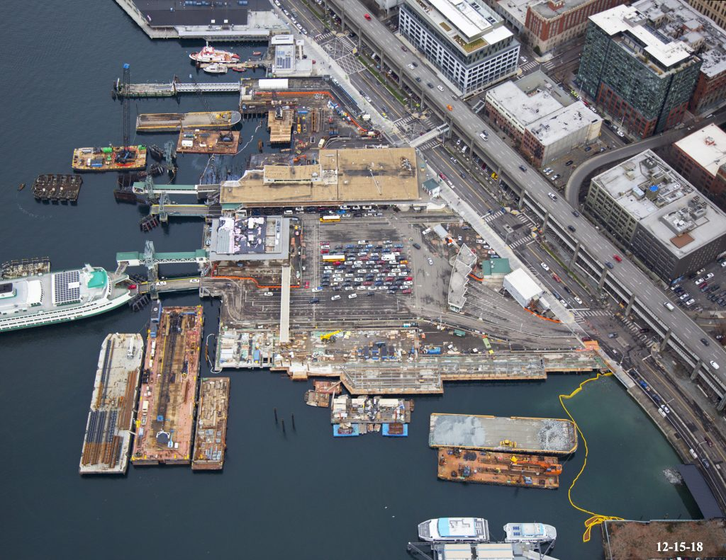
COLMAN DOCK TRANSIT HUB

Slide 29
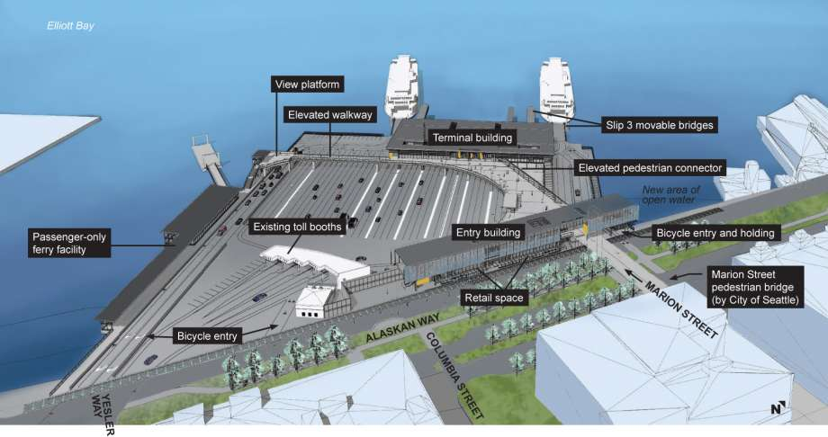
COLMAN DOCK TRANSIT HUB

Slide 30
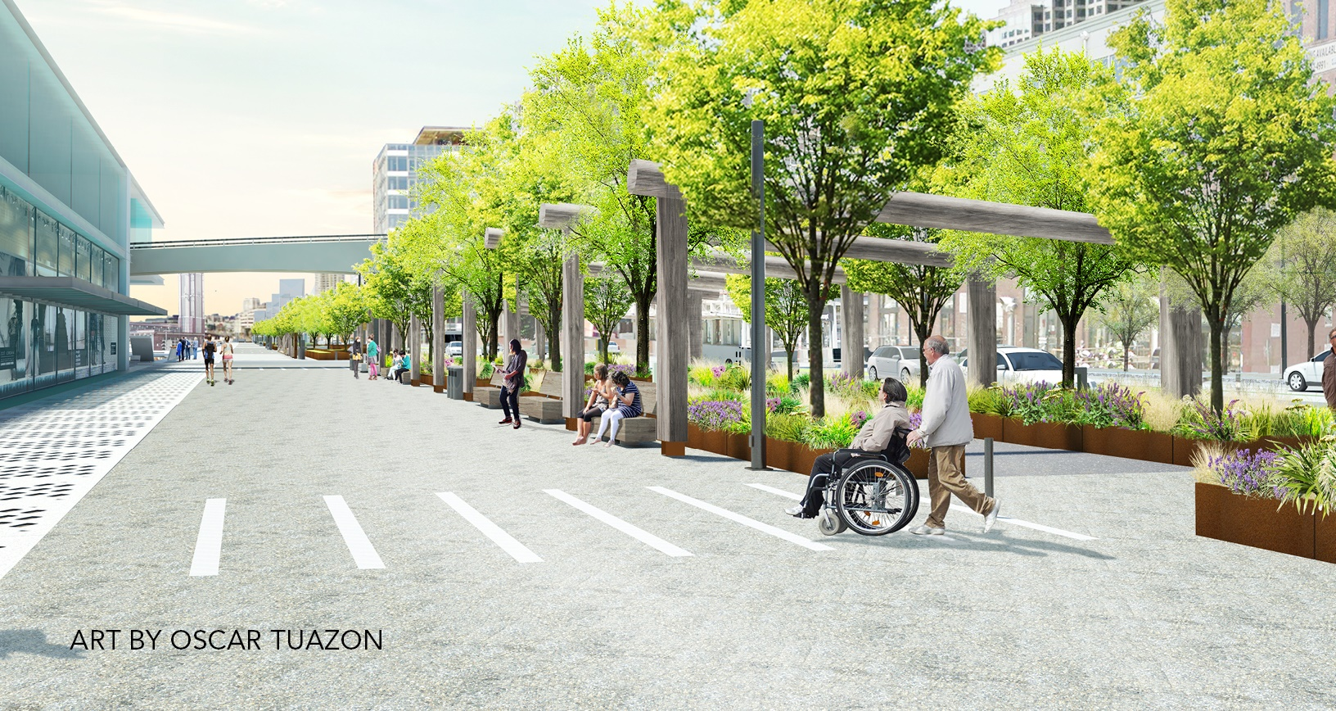
COLMAN DOCK TRANSIT HUB

Slide 31
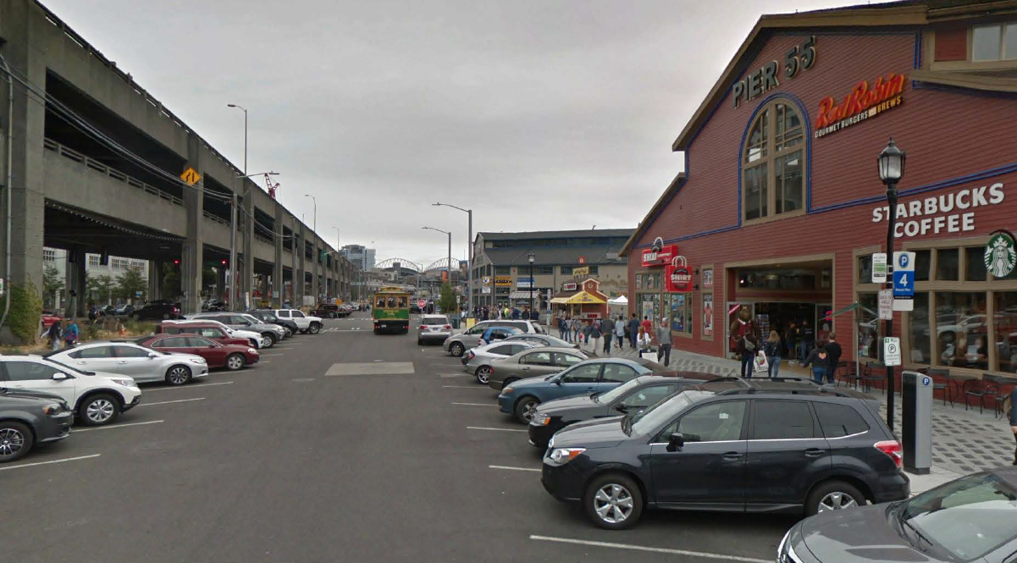
HISTORIC PIERS TODAY

Slide 32
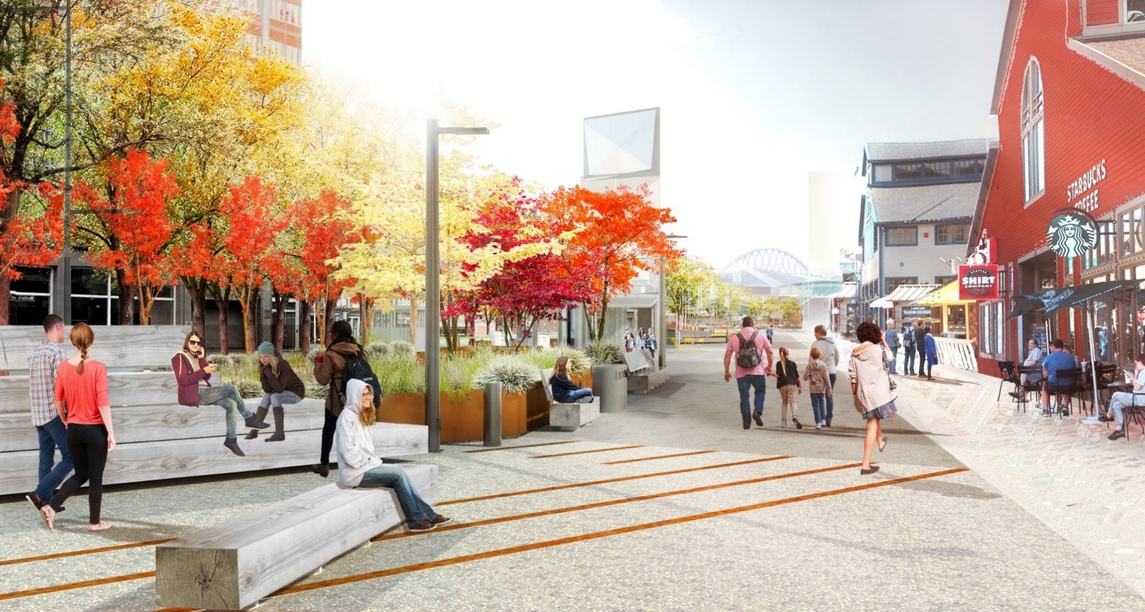
PIER PROMENADE

Slide 33
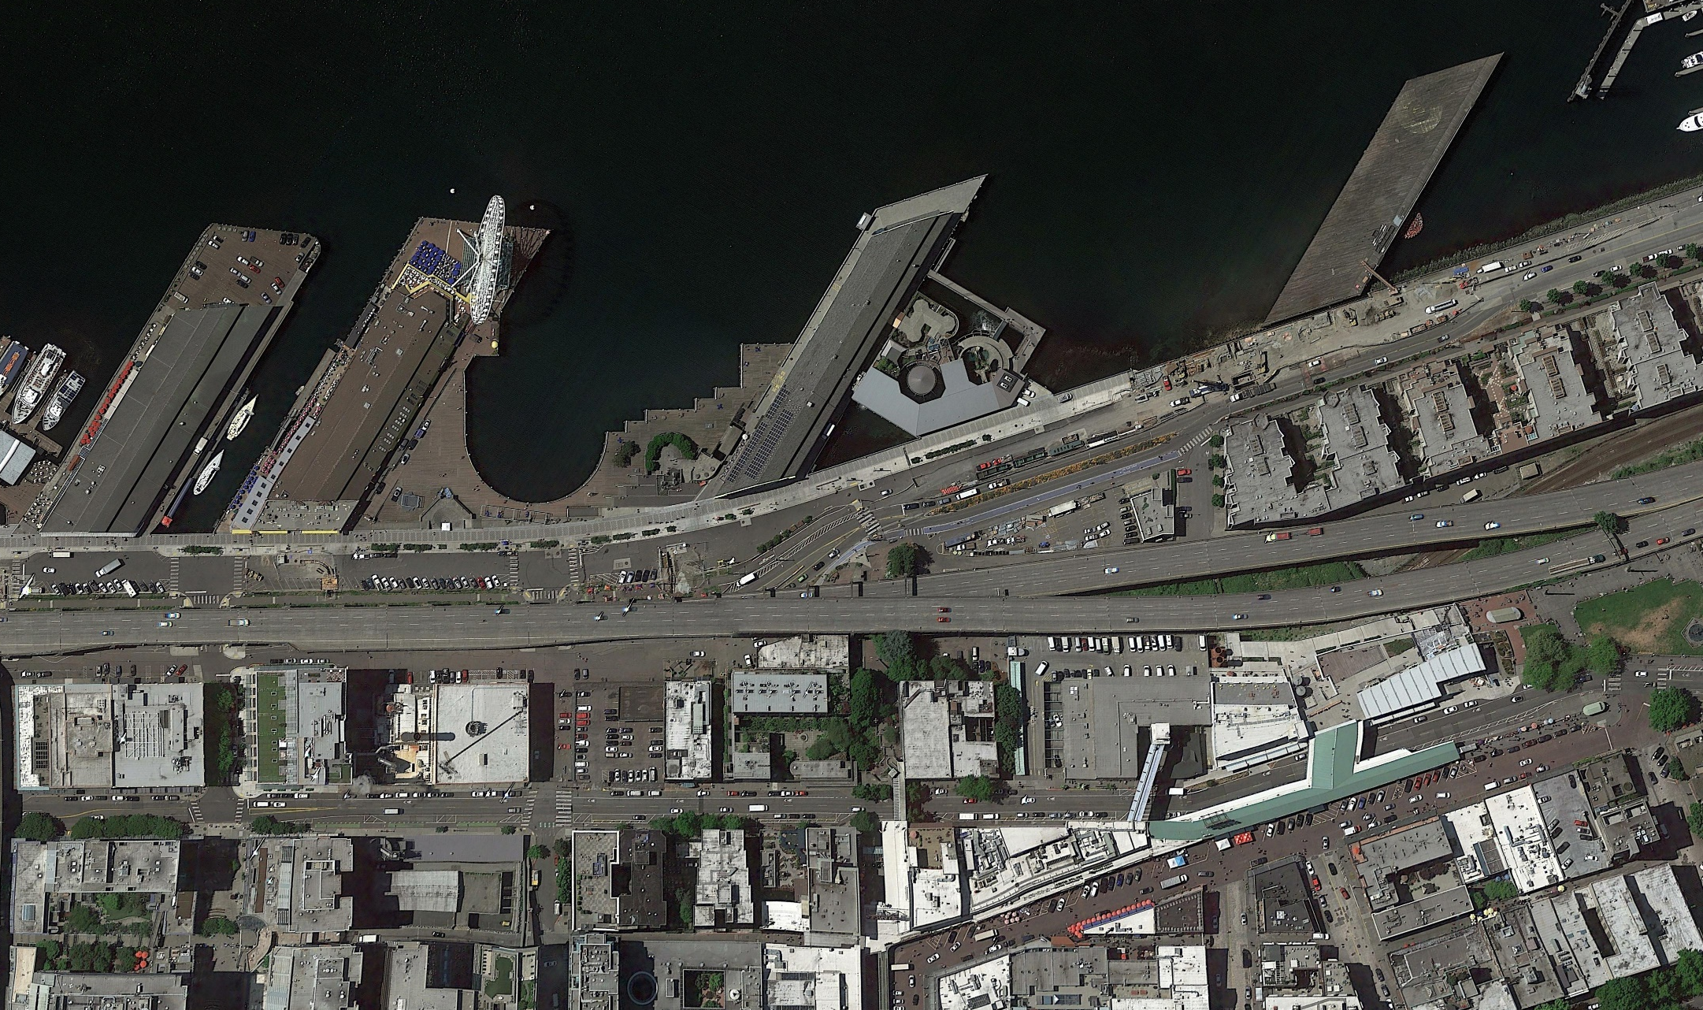
CENTRAL PUBLIC SPACES

Slide 34
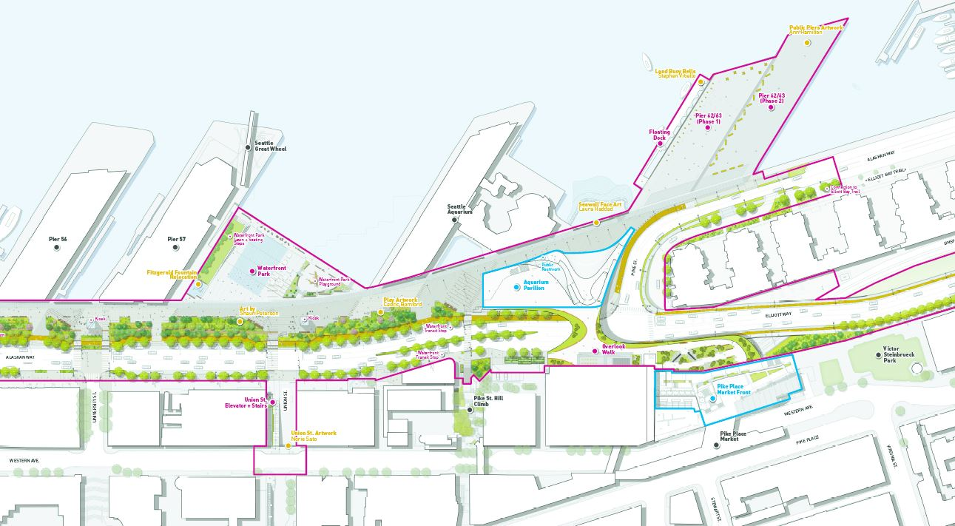
CENTRAL PUBLIC SPACES

Slide 35
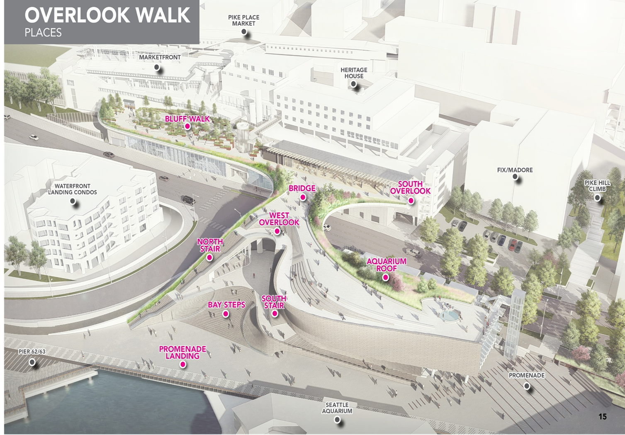
OVERLOOK WALK

Slide 36
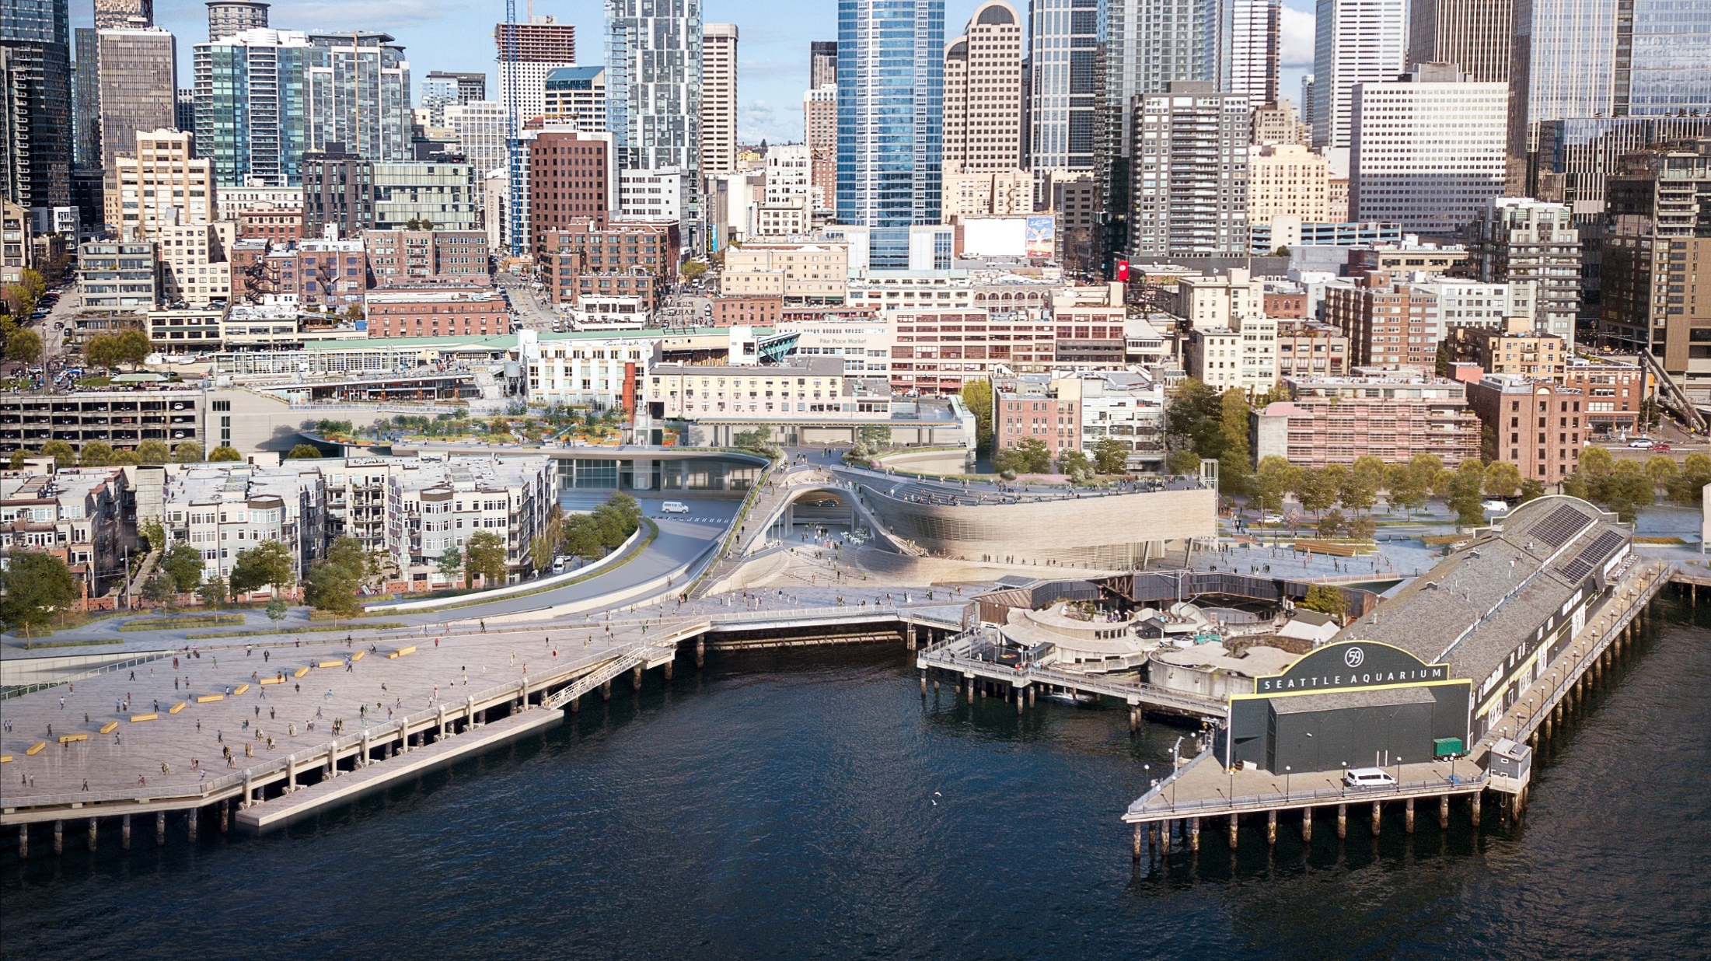

Slide 37
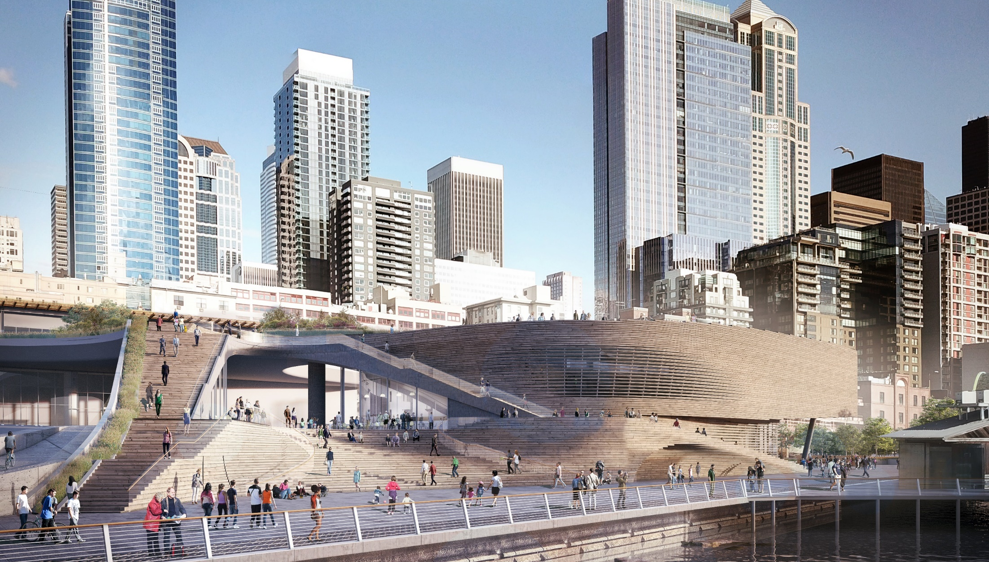

Slide 38
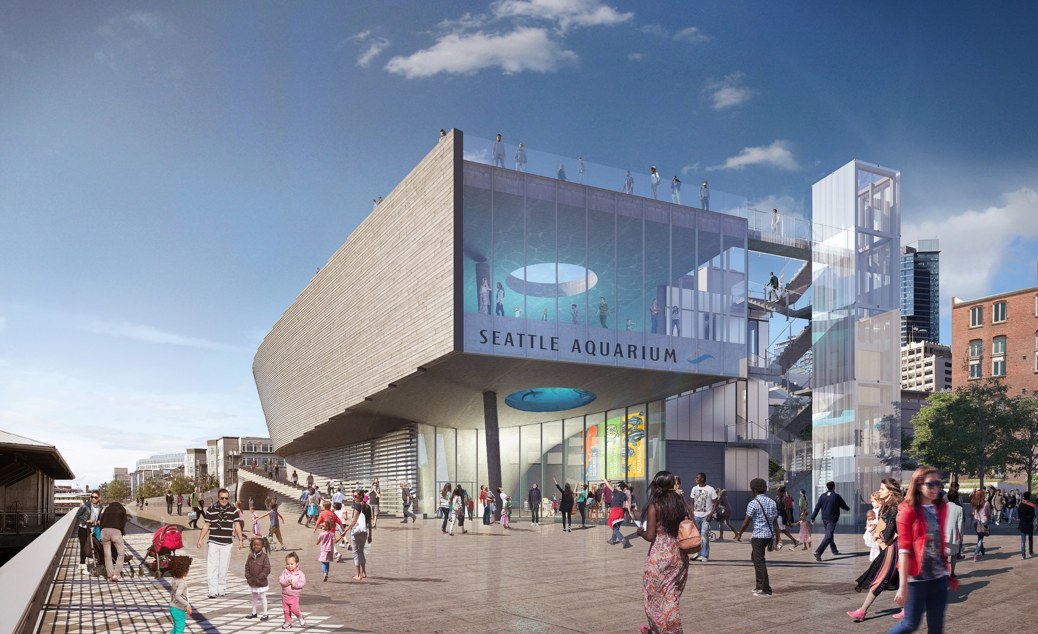

Slide 39
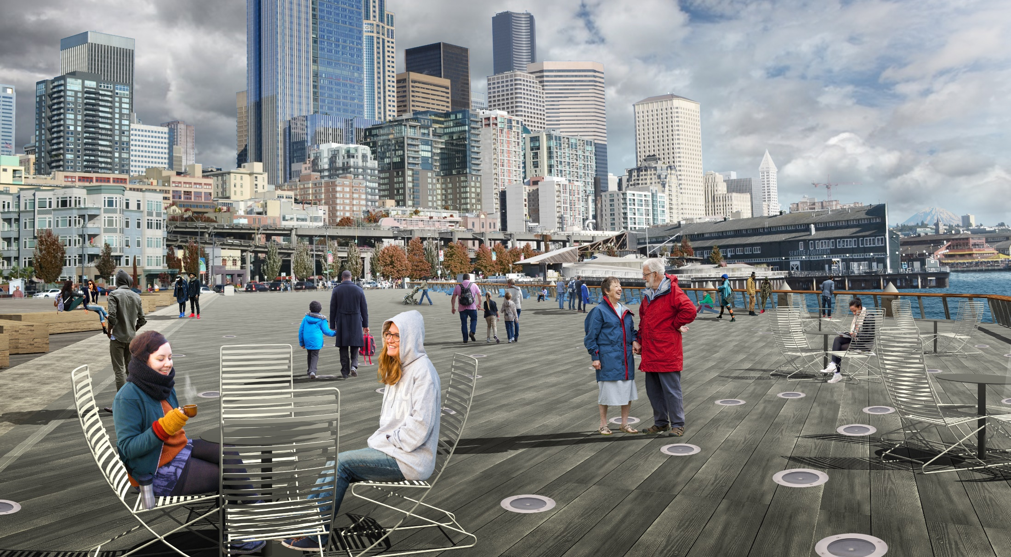
PIER 62 – OPENING EARLY 2020
26
Notes:
Movable seating and lighting embedded in the deck will provide space for gathering, walking, and enjoying views.

Slide 40
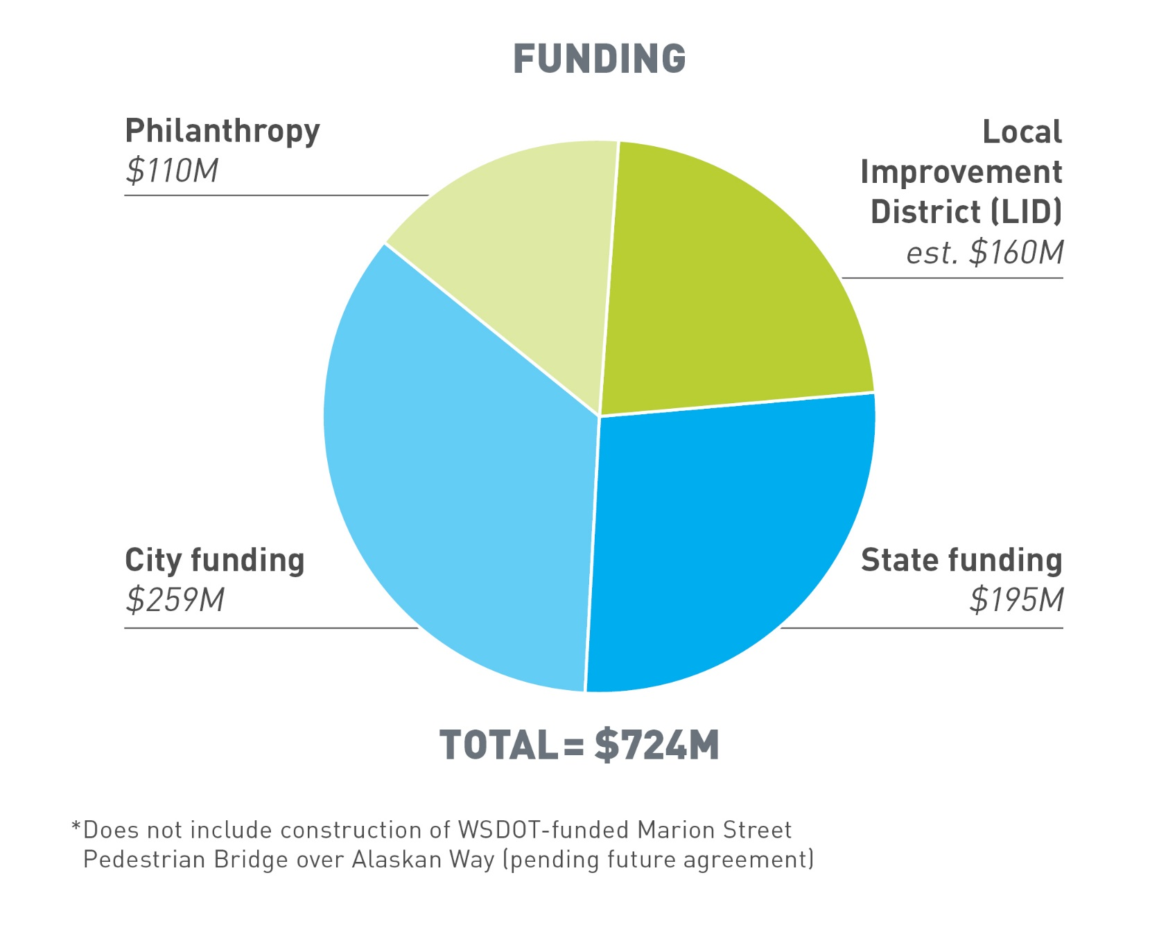
WATERFRONT SEATTLE FUNDING

Slide 41
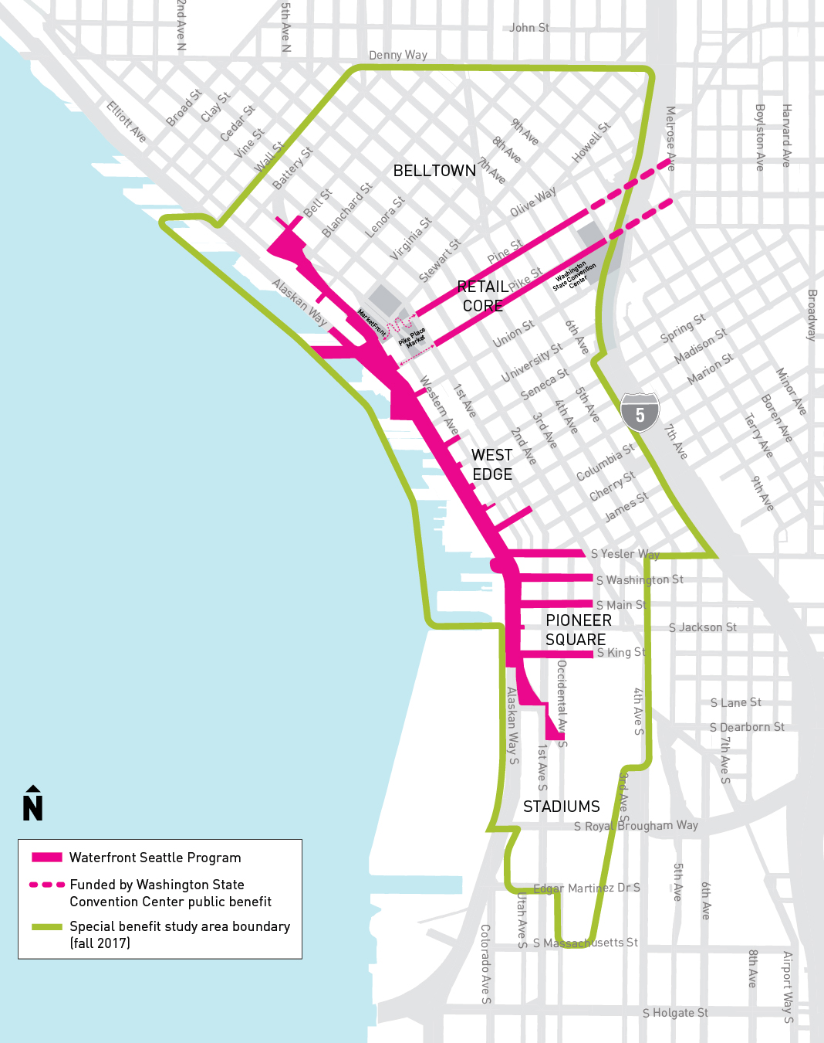
WATERFRONT LOCAL IMPROVEMENT
DISTRICT (LID)
Total parcels: 6,130 (4,960 condominiums)
Total appraised value: $49B
Total special benefit from the new waterfront:
$415M ($58M condominiums)
Total Assessment:
$160M
Assessment ratio:
38% of total benefit

Slide 42
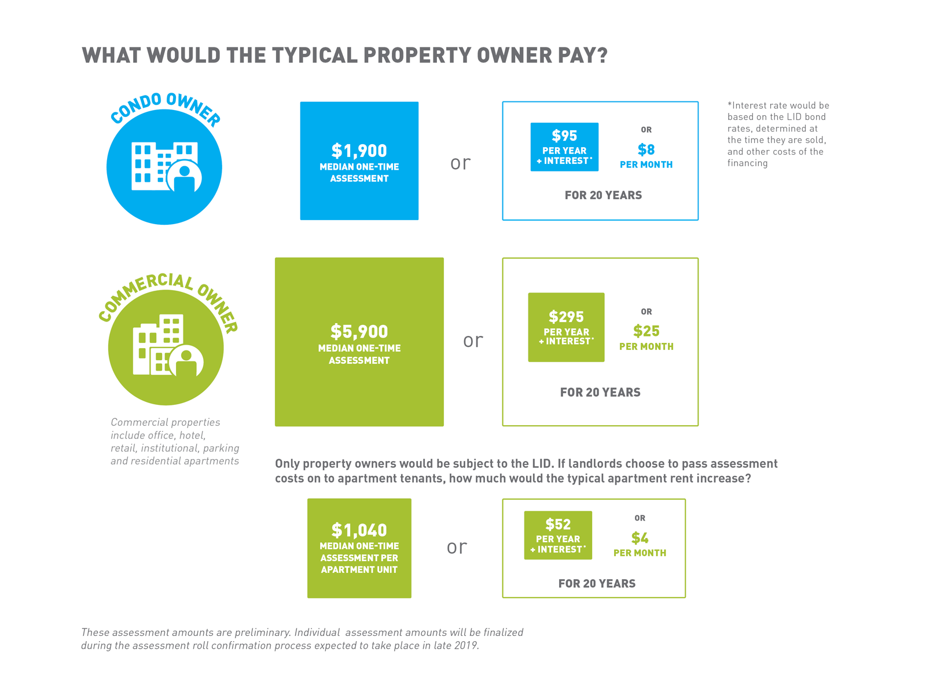

Slide 43
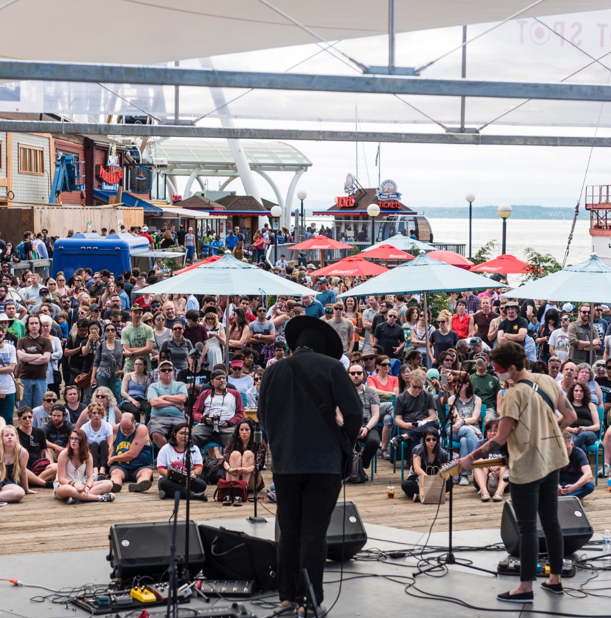
WATERFRONT PARK OPERATIONS
Partnership with non-profit “Friends” organization:
$4.8M Annual City funding for maintenance
$1-$2M private fundraising for programming and activation
Free public events year round
Dedicated, specialized maintenance team
Oversight Committee to ensure accountability
33
Notes:
Partnership between City and Friends of Waterfront Seattle to deliver a package of enhanced operations and maintenance:
Activities and events year round
Dedicated and specialized maintenance team
Managed spaces with full time concierge staff and private security
Additional concession and retail offerings
Dedicated annual City budget of $4.8 million (2023), private fundraising $1-$2 million
Transparency and accountability to ensure the waterfront is a democratic and inclusive space

