Slide 1
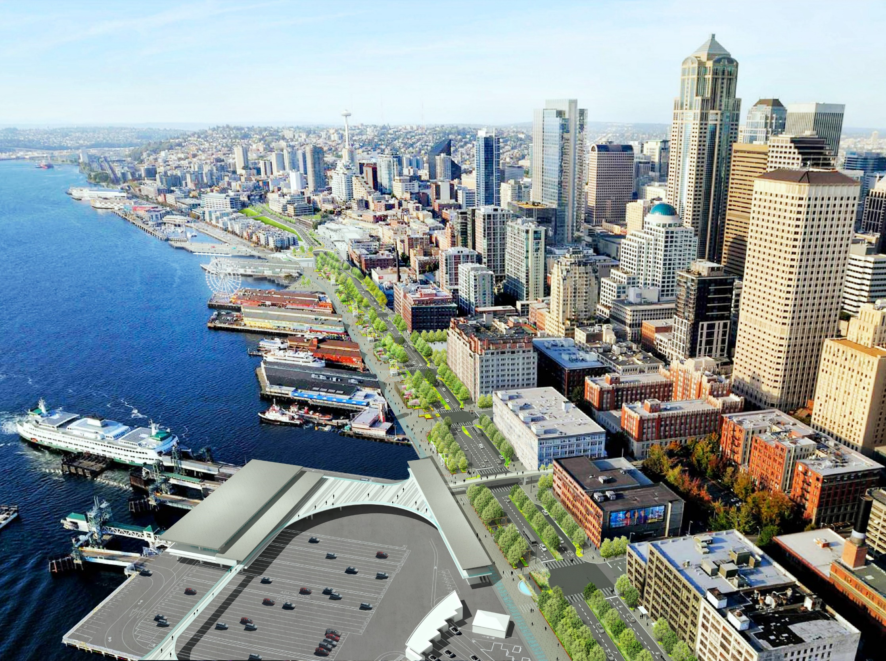
PIONEER SQUARE EAST-WEST STREETS
December 2023

Slide 2
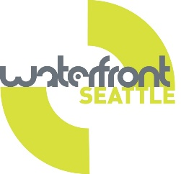
Participation
We will have a Q&A after the presentation.
Please send in your questions using the chat or use the raise hand function to be unmuted.

Slide 3
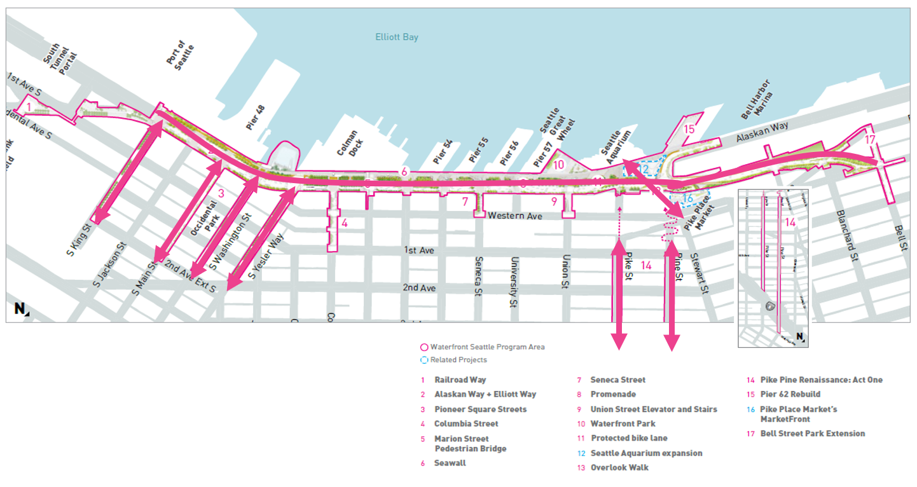
WATERFRONT SEATTLE PROGRAM AREA
Notes:
First, we are going to give you a little background on the Waterfront program. The Waterfront program is made up of 15 projects that will make it easier for everyone to access, interact with, and experience this incredible location through improved accessibility and increased programming.

Slide 4
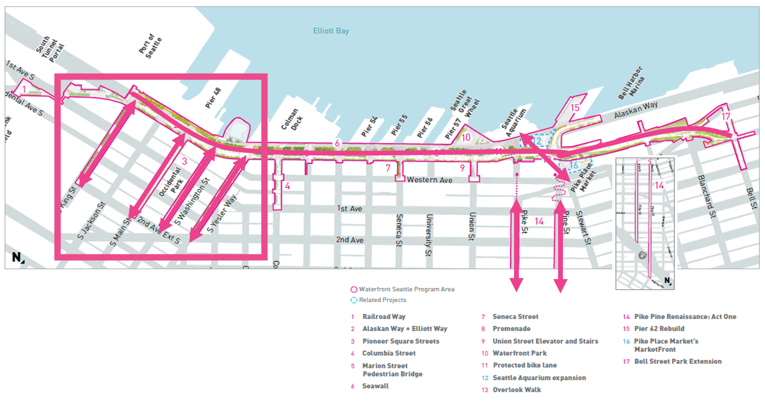
WATERFRONT SEATTLE PROGRAM AREA: PIONEER SQUARE
Notes:
Connecting the city to the waterfront is another big focus of this program. The Overlook Walk will provide a direct connection between Pike Place Market and the waterfront; the Pike Pine Renaissance project will connect the waterfront to central downtown and Capitol Hill; and, in the pink box to the left, the Pioneer Square East-West Streets Pedestrian Improvements Project will make it easier to walk to Pioneer Square from the new waterfront. Let’s zoom in a little closer

Slide 5
PROJECT VALUES & OUTREACH

Slide 6
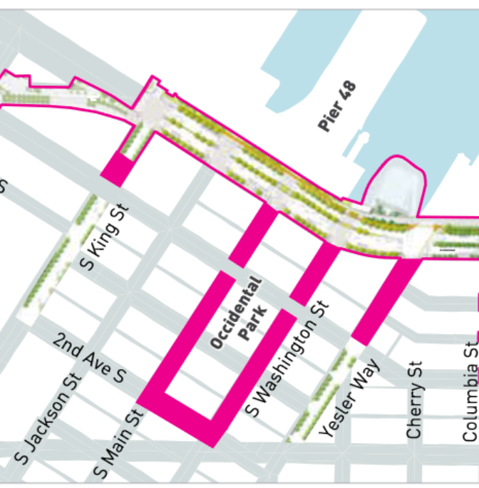
PIONEER SQUARE EAST-WEST STREETS
Reconnect the core of Pioneer Square to the new waterfront promenade
Provide safe, accessible and convenient pedestrian connections, and foster positive city life and activity.
Notes:
The Pioneer Square East-West Streets Pedestrian Improvement project focuses on reconnecting the core of Pioneer Square to the new waterfront promenade through a series of high-impact pedestrian improvements on portions of Yesler Way, South Washington Street, South Main Street and South King Street between Alaskan Way and Second Avenue.
The project’s primary objectives are to provide safe, accessible and convenient pedestrian connections, and to foster positive city life and activity.

Slide 7
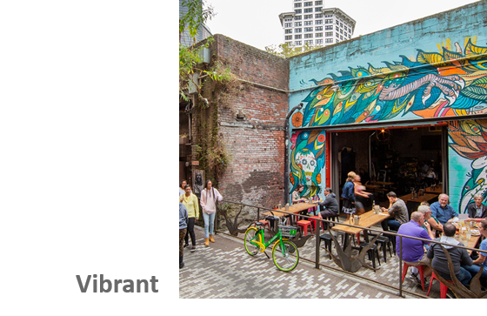
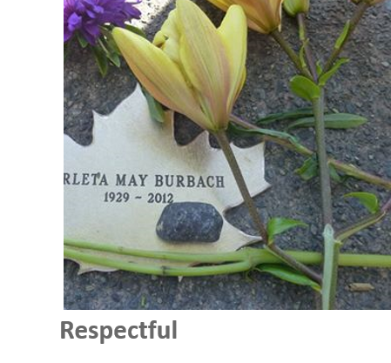
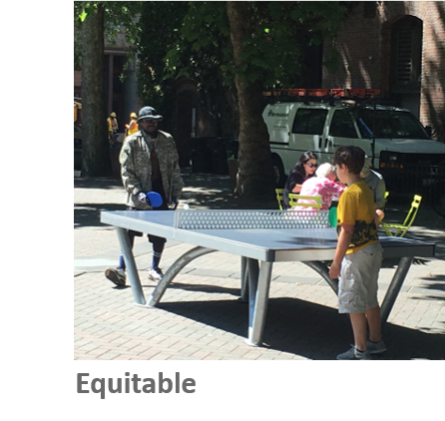
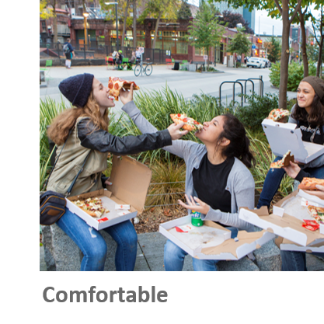
PROJECT VALUES
Notes:
The project is centered around several key values, including making these spaces vibrant, more accessible, comfortable, and equitable while also being respectful of the rich history and community that lives in Pioneer Square.

Slide 8
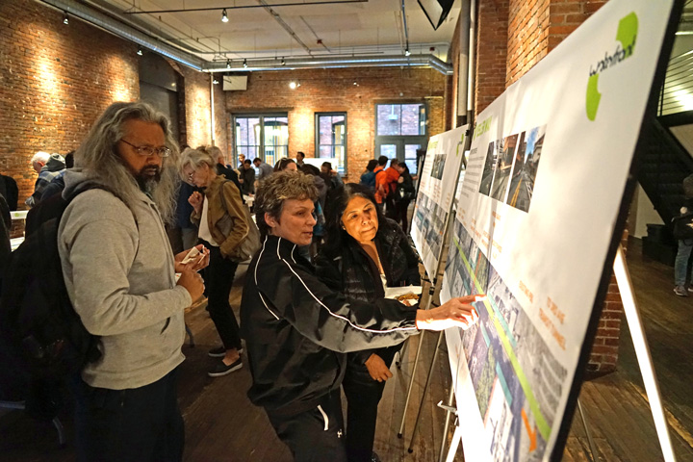
WHAT WE’VE HEARD: DESIGN
Maximize pedestrian space on east-west streets
Convert Main and Washington to narrow, one-way streets
Build raised intersections and curbless streets to improve access for all
Address safety for all, including pedestrian safety
Prioritize vehicle loading zones over short-term parking spots
Respect the lived experiences and cultures of indigenous and Coast Salish people
Notes:
Through extensive public outreach, including two community open houses between April and July 2019, we’ve heard from more than 170 people and received over 200 comments on our online open house.
The key takeaways were to:
Maximize pedestrian space on east-west streets
Convert Main and Washington to narrow, one-way streets
Build raised intersections and curbless streets to improve access for all
Address safety for all, including pedestrian safety
Prioritize vehicle loading zones over short-term parking spots, and
Respect the lived experiences and cultures of indigenous and Coast Salish people

Slide 9
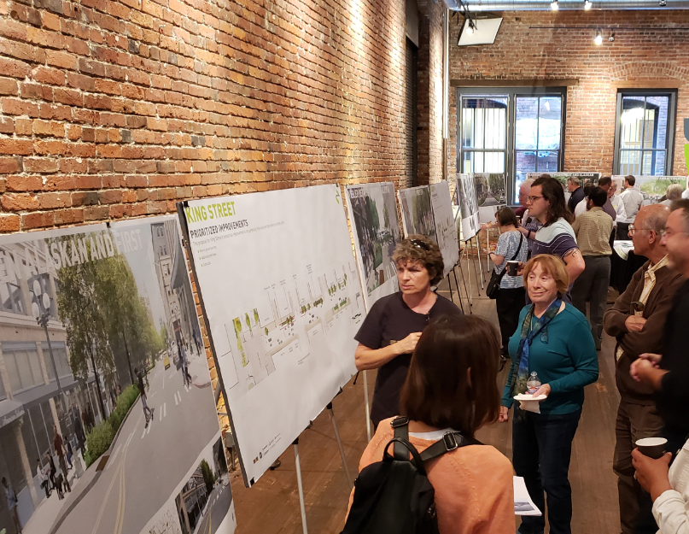
WHAT WE’VE HEARD: FINAL DESIGN
Support for bike safety, bike-friendly intersections, more bike lanes, and improved accessibility for people using wheelchairs navigating areas in general downtown
Questions regarding upkeep and maintenance of project once complete
Support for bollards or other separation between vehicle lanes and curbless streets
Notes:
We have also conducted online open houses and meetings during the 60% design phase and we have started reaching out to residents & businesses in the neighborhood in preparation for construction start.

Slide 10
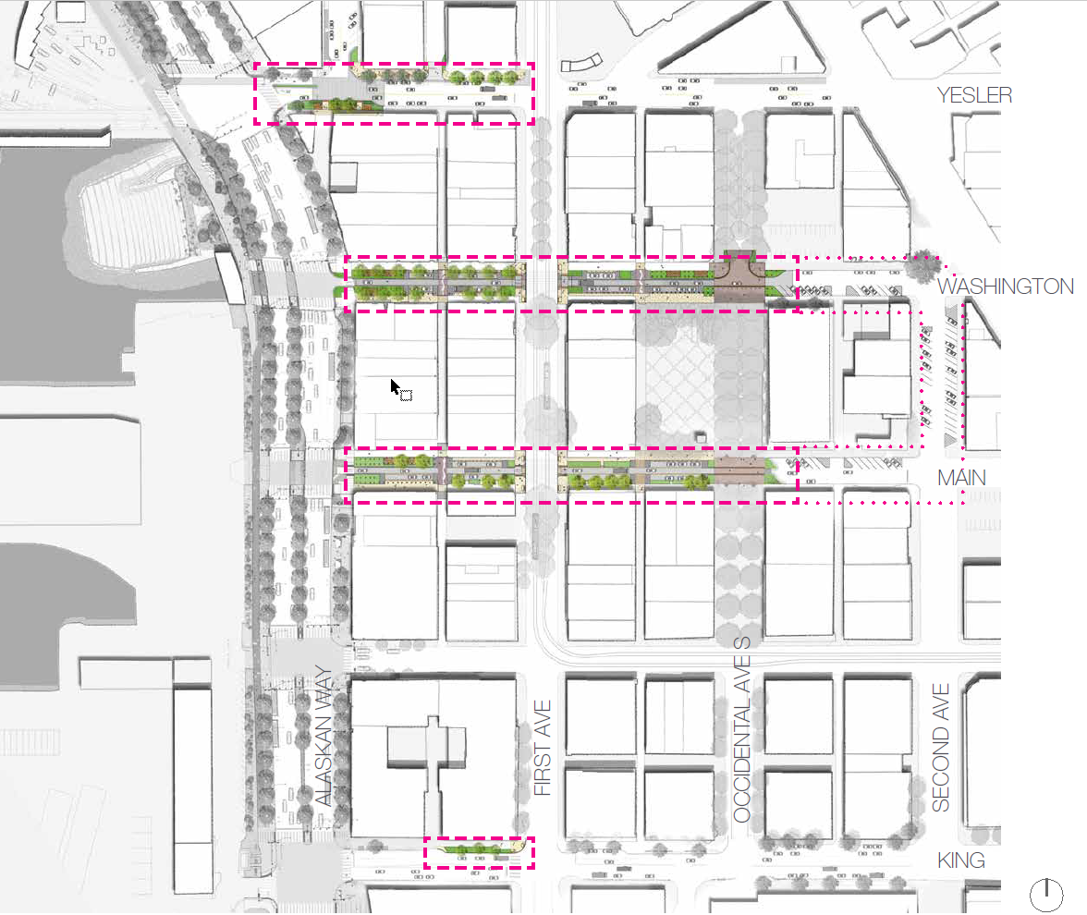
PROJECT PLAN VIEW
Notes:
As we mentioned, the project focuses on four key east-west connections, including Yesler Way and South Washington, South Main and South King streets. Through site analysis and conversations with the community, the areas within the dashed boxes were identified as the most transformational opportunities for pedestrians in the neighborhood. We’ll now step through each street going first to Yesler, then discussing South Washington and South Main, then, finally, South King Street.

Slide 11
DESIGN

Slide 12
EXISTING CONDITIONS: S WASHINGTON ST
Pioneer Square East West Street Pedestrian Improvements

Slide 13
EXISTING CONDITIONS: S MAIN ST
Pioneer Square East West Street Pedestrian Improvements

Slide 14
TRAFFIC REVISION + AREAWAYS
Pioneer Square East West Street Pedestrian Improvements

Slide 15
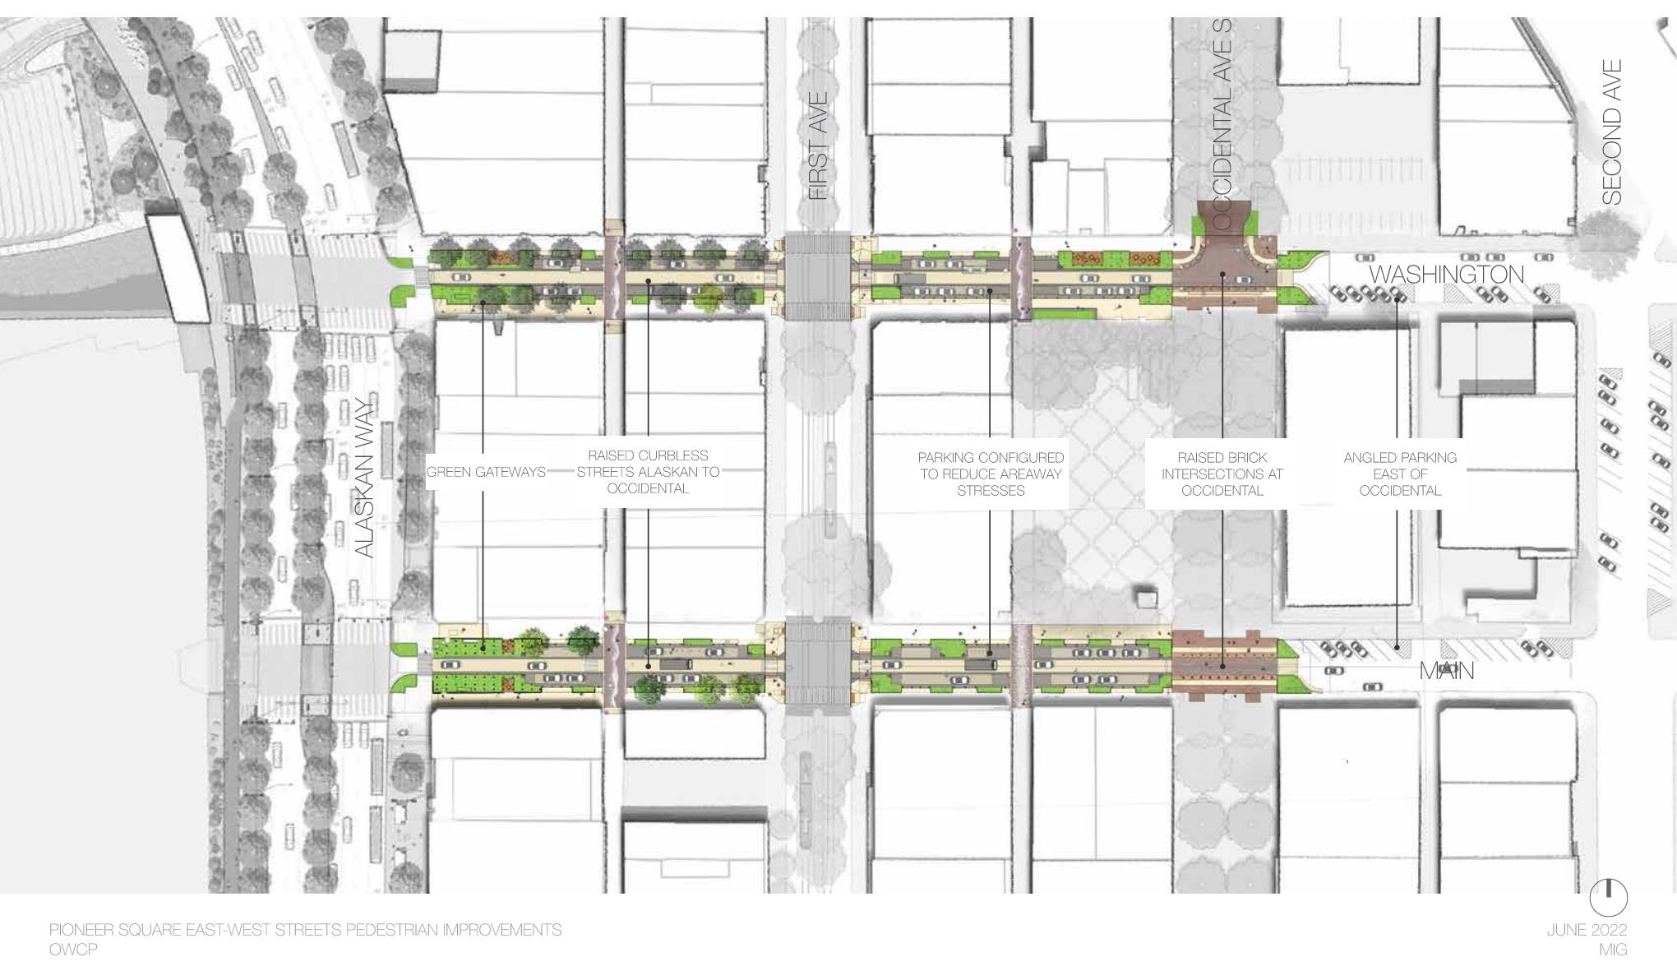
S WASHINGTON ST + S MAIN ST PLAN
Pioneer Square East West Street Pedestrian Improvements

Slide 16
TRAFFIC REVISION:
ONE-WAY STREETS
Pioneer Square East West Street Pedestrian Improvements

Slide 17
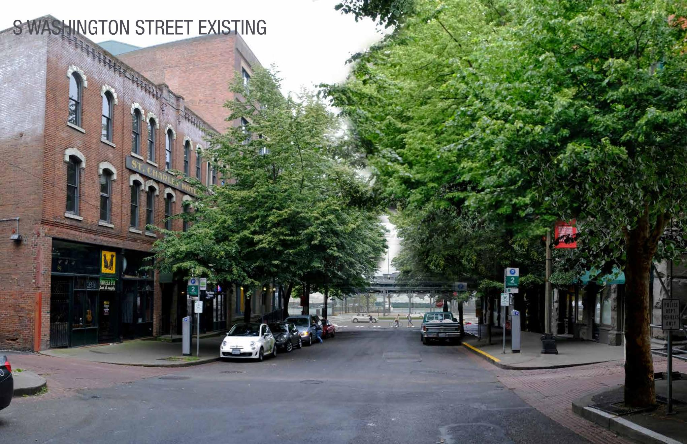
S WASHINGTON ST – EXISTING

Slide 18
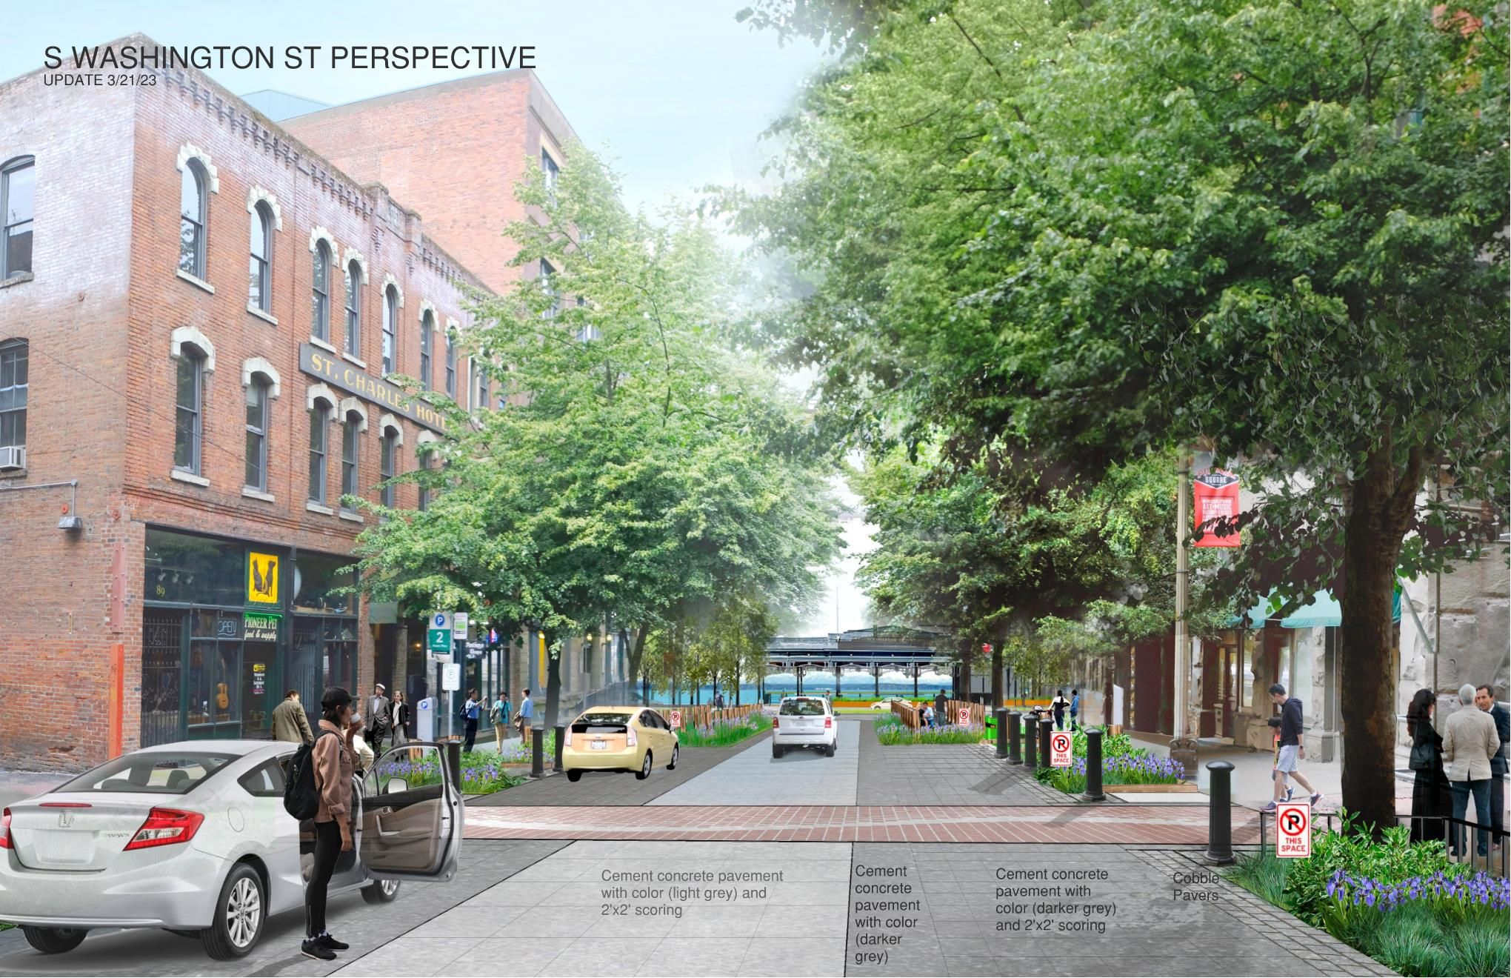
S WASHINGTON ST – DESIGN LOOKING WEST

Slide 19
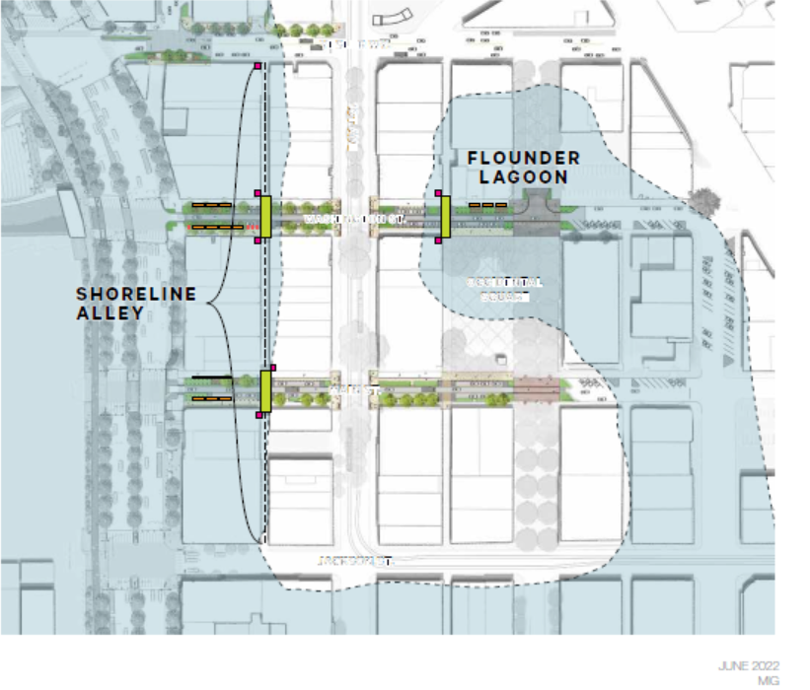
SHORELINE ALLEY
Renderings by MIG
Notes:
The Pioneer Square East West streets are also some of the first times within the entire waterfront program where the project’s improvements cross the City’s original shoreline. That idea is memorialized in the “Shoreline Alley paving,” shown here in the middle of the image, which makes an explicit allusion to the historic edge of the water.

Slide 20
NATIVE PLANTINGS & USAGE EXPLANATIONS
Native plantings selected based on fit & history
Kickrails with information about historical usage of the plants
(example renderings via MIG)
Rendering by MIG

Slide 21
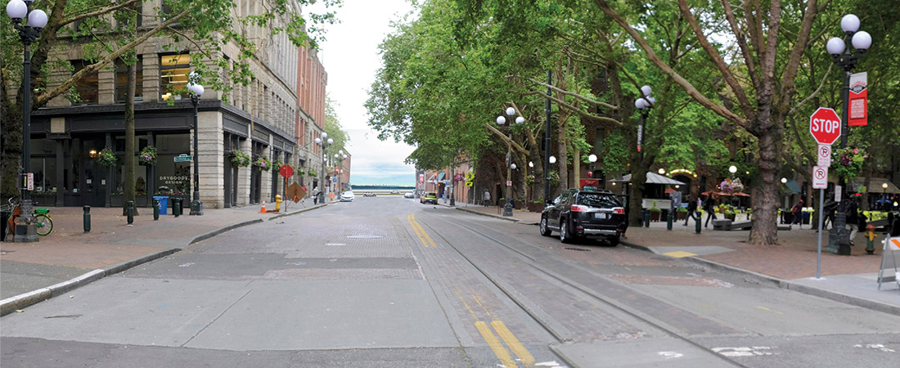
MAIN STREET – PRESENT DAY
Notes:
Today, Main Street at Occidental Mall looks like this, with almost forty feet of roadway pavement for pedestrians to traverse and a pastiche of paving materials

Slide 22
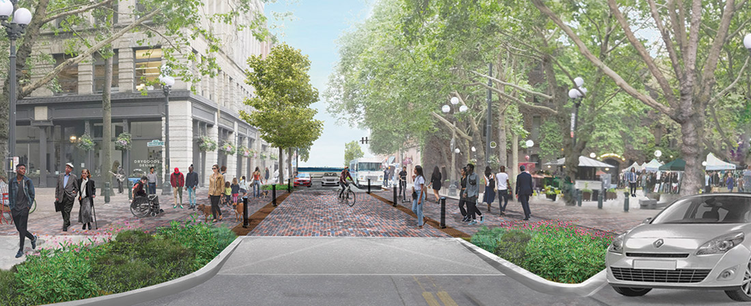
MAIN STREET DESIGN
LOOKING EAST
Rendering by MIG
Notes:
Once constructed, the revamped Main Street and Occidental Mall intersection will be transformed for all users. With bollards protecting pedestrians, the curbless intersection will make the space more accessible and pedestrian friendly. The project’s consistent brick pavers gently fold into Pioneer Square’s existing materials palette while the new native plantings—including evergreen huckleberry, salal, Douglas asters, camas and lupines—connect the site to its ecological past and provide habitat for birds and butterflies on this land once again.

Slide 23
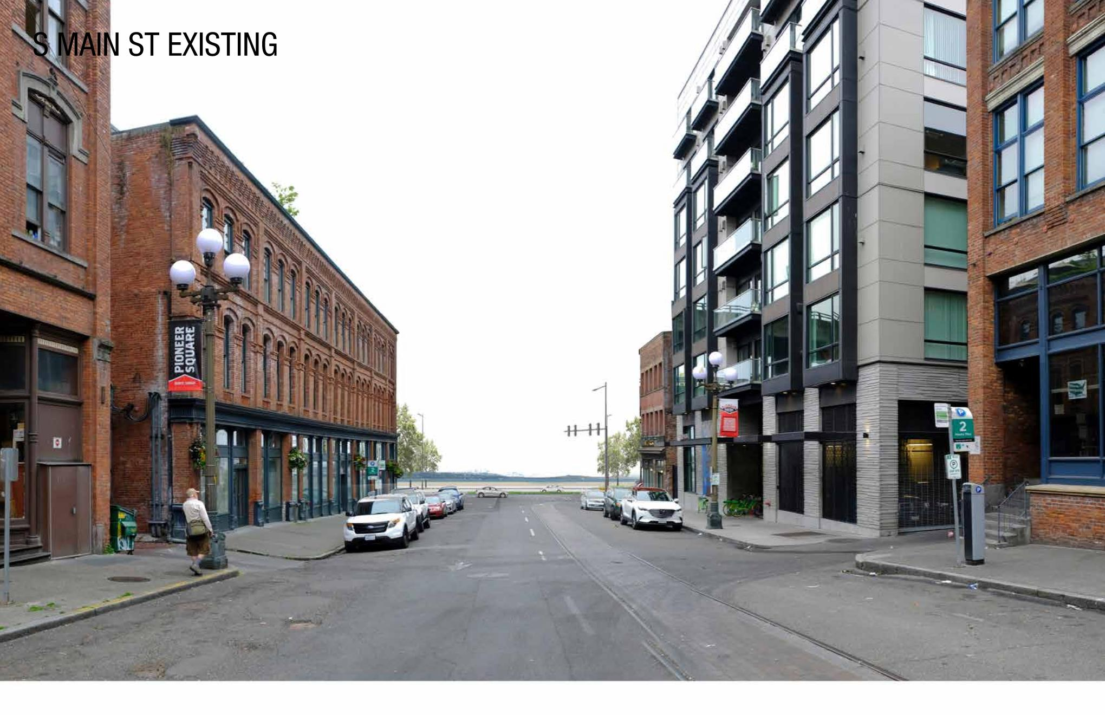
S MAIN ST – EXISTING
Pioneer Square East West Street Pedestrian Improvements

Slide 24
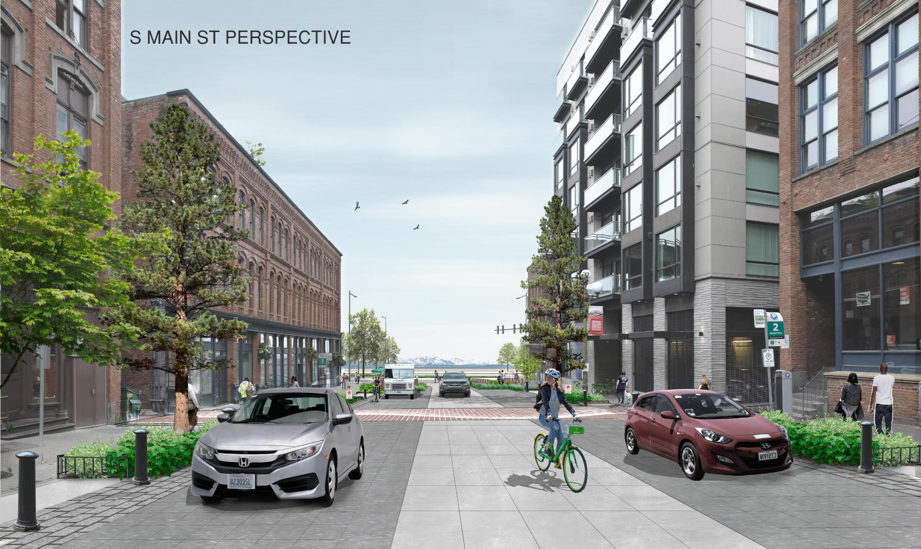
S MAIN ST – DESIGN
Pioneer Square East West Street Pedestrian Improvements

Slide 25
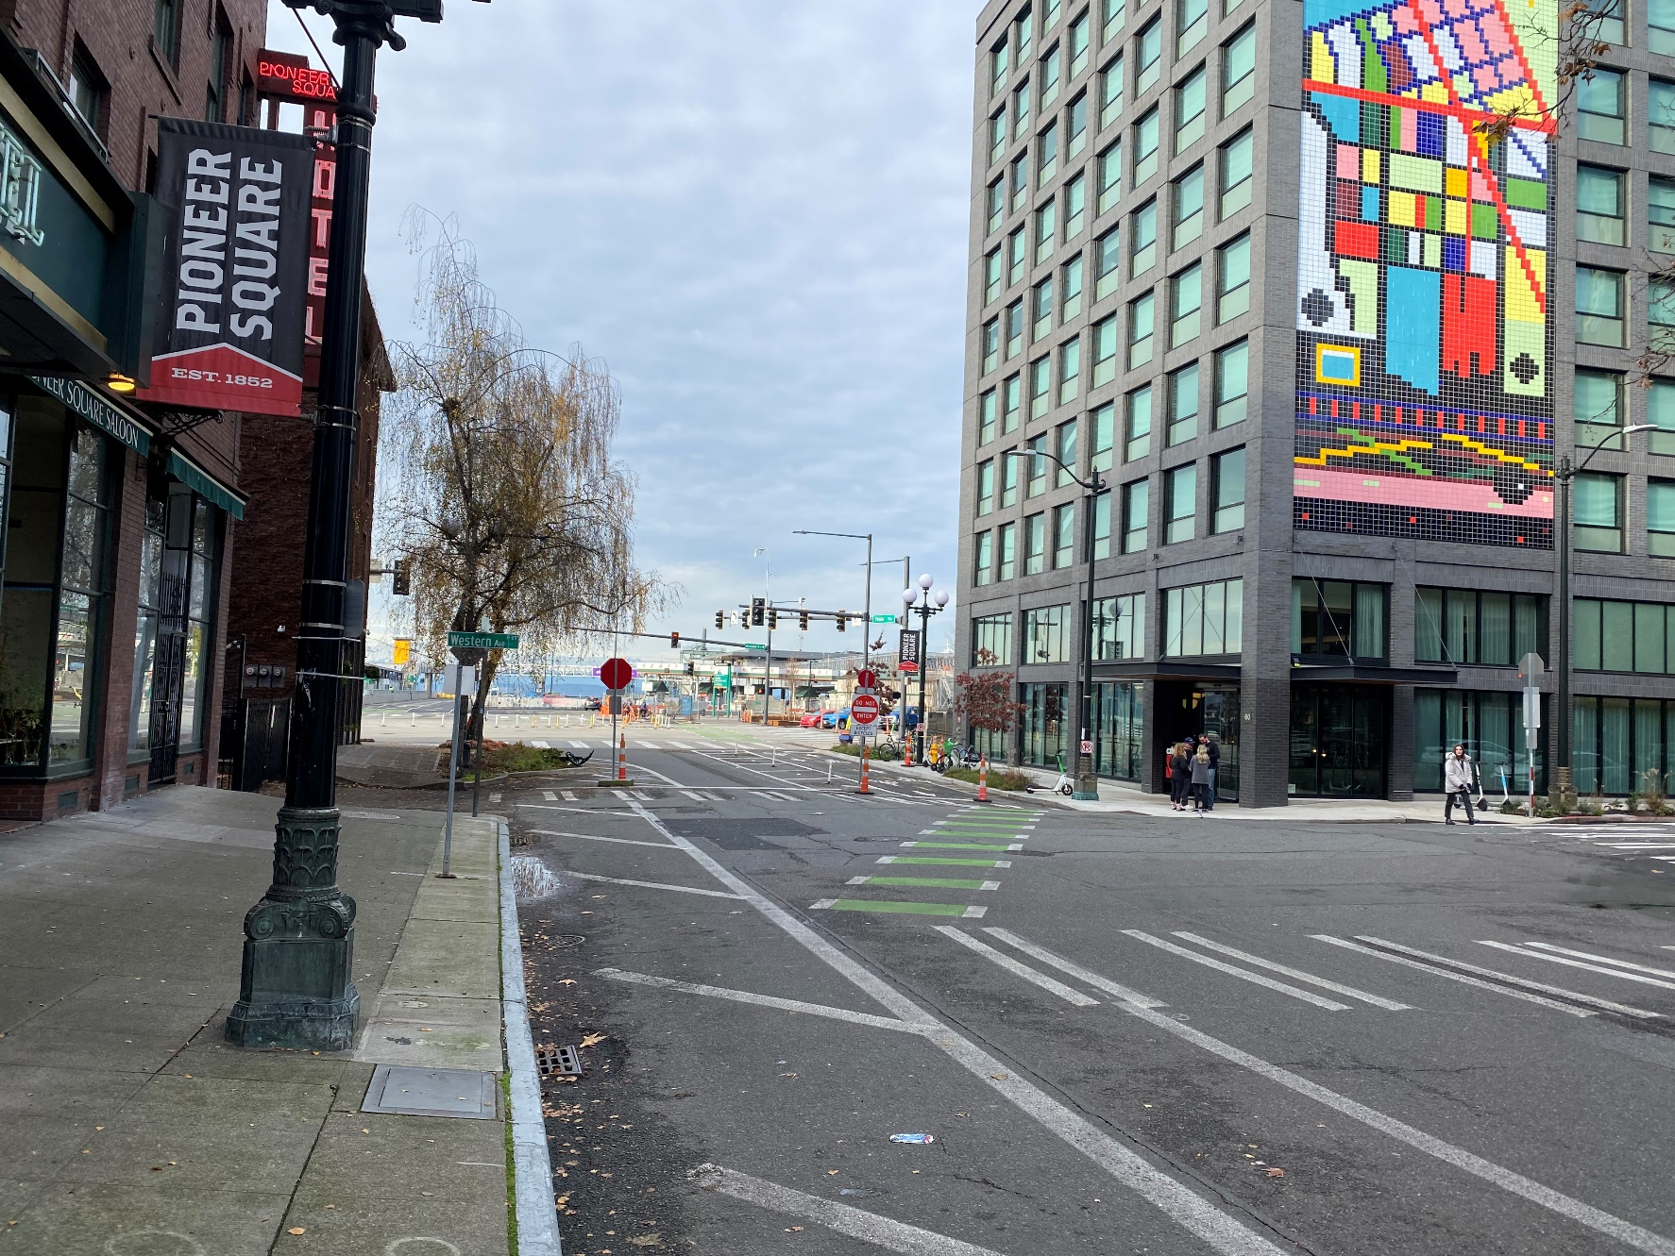
YESLER WAY – PRESENT DAY
Notes:
In addition to the improvements along the north side of Yesler, the design capitalizes on site-specific opportunities at Yesler and Western. Already without the Viaduct you can get a sense of the panoramic sweep that pedestrians pausing at the south side of Yesler Way and Western Avenue can enjoy. The view is one of those “only-in-Seattle” moments where one can glimpse the snow-capped Olympics to the left and the gleaming terracotta façade of Smith Tower to the right.

Slide 26
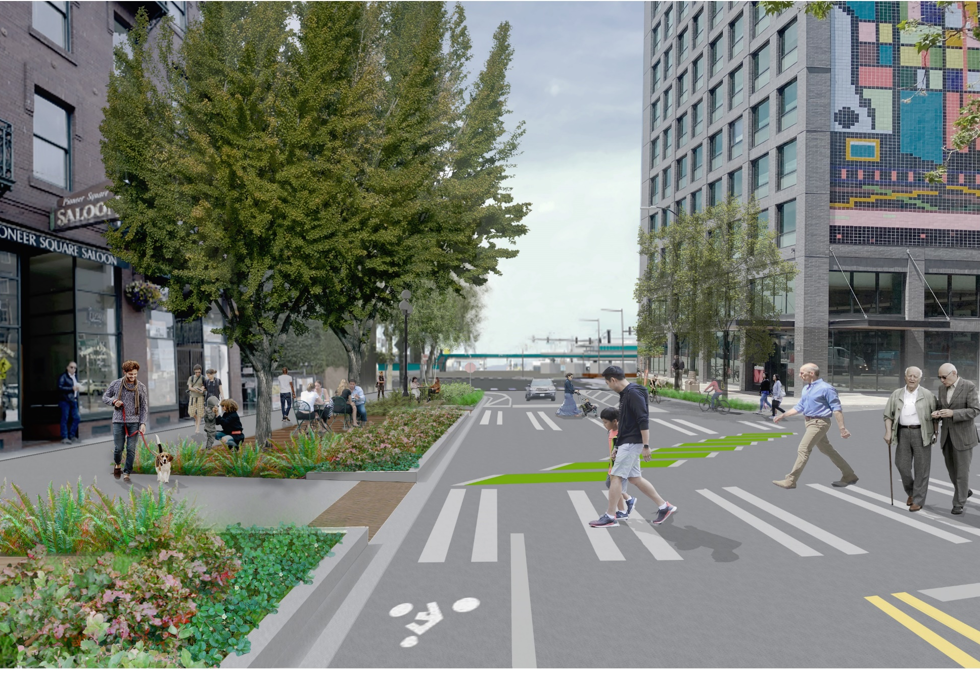
YESLER WAY DESIGN
Notes:
Here the design transforms the simple sidewalk into an engaging outdoor room, buffered from the street by a planted raingarden. Inspired by the stacked lumberyards of Henry Yesler’s original mill that sat on this site in the 1800s, timber decking, benches and sidewalk cafes provide Pioneer Square visitors with a place to sit, rest and take in local and regional scenery under a pair of distinctive new street trees.

Slide 27
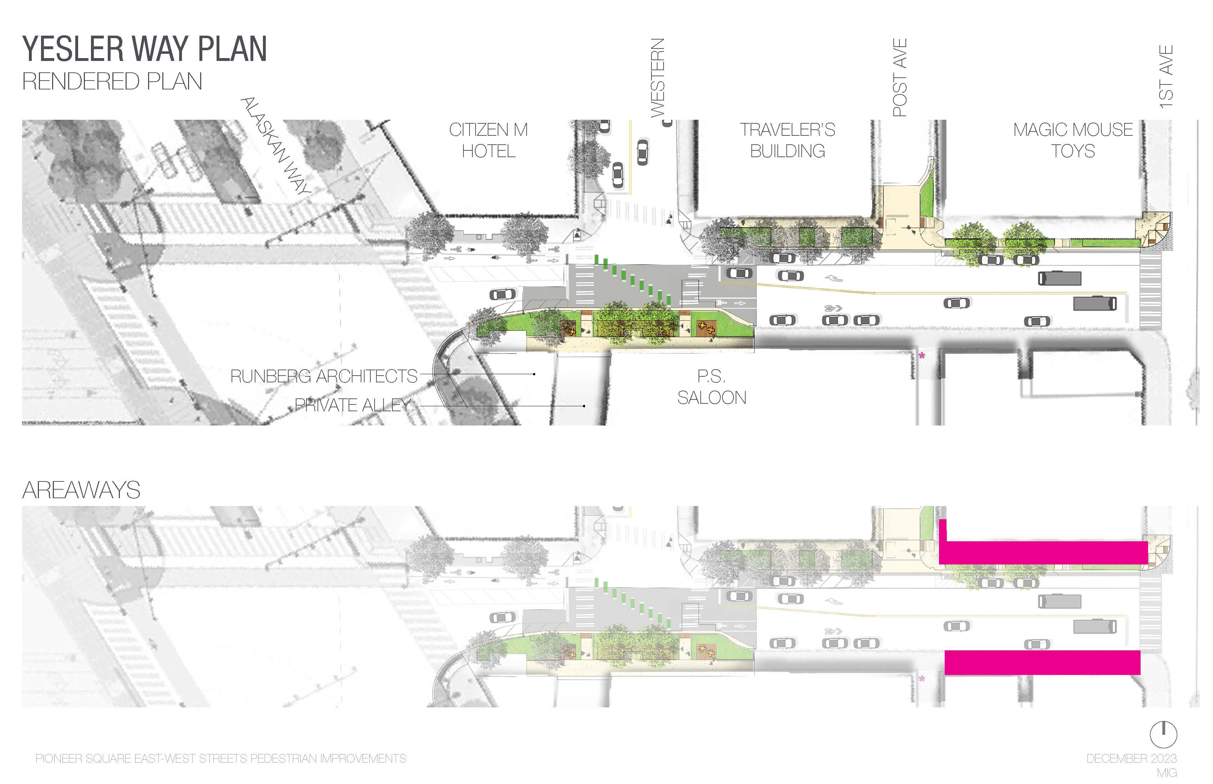
YESLER WAY PLAN

Slide 28
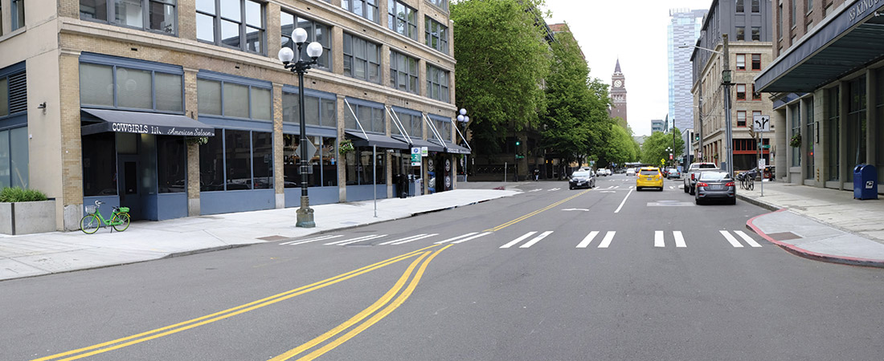
KING STREET – PRESENT DAY
Notes:
The improvements to King Street are more modest in nature, extending the greening that was recently installed by the new development at Alaskan and King further to the west to connect with Occidental Mall and King Street Station.

Slide 29
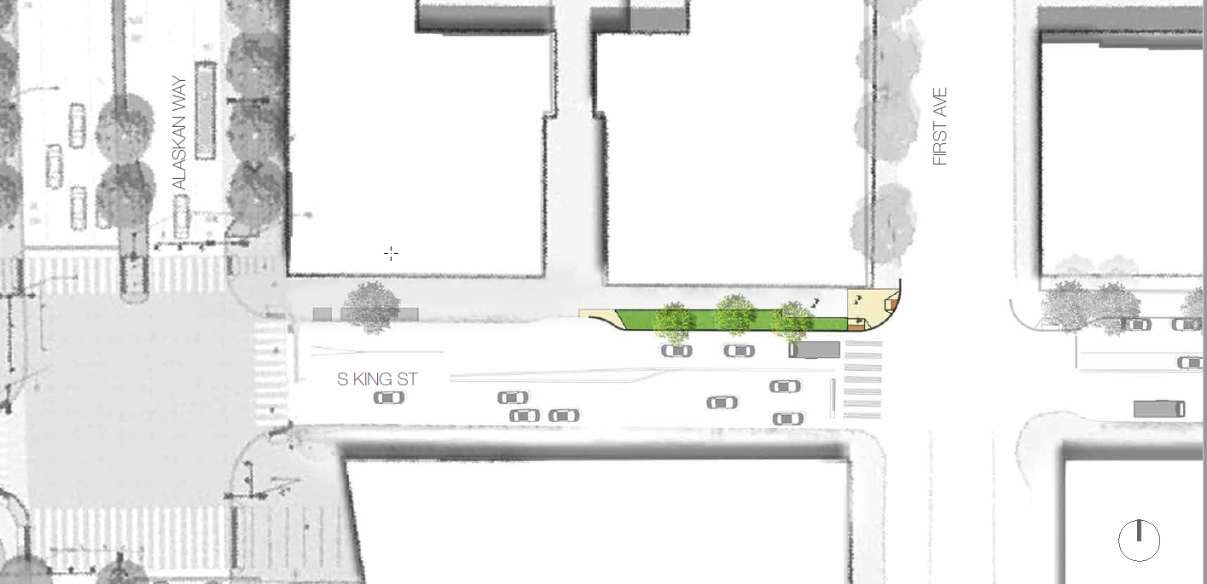
KING STREET PLAN
Rendering by MIG
Notes:
A new curb bulb shortens the King Street crossing at First Avenue and allows more greenery—shrubs, perennials and trees—to take root making a more human scaled pedestrian experience and giving some relief from the sun during the warm summer months. The mid-block crossing is removed focusing pedestrian crossings to the intersections.

Slide 30
CONSTRUCTION & SCHEDULE

Slide 31
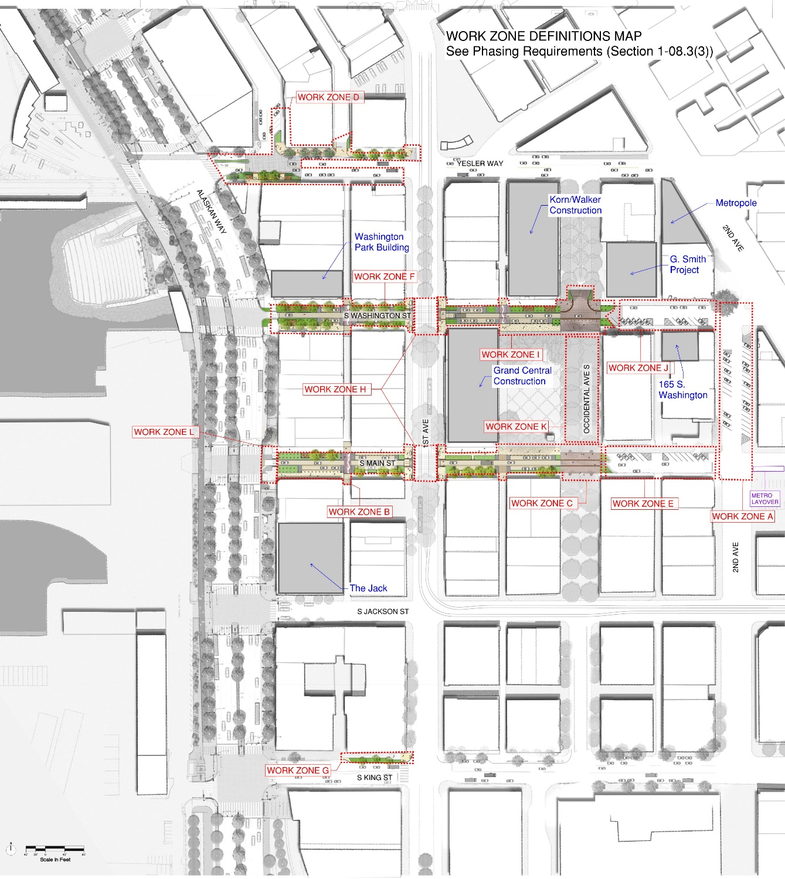
WORK ZONES

Slide 32
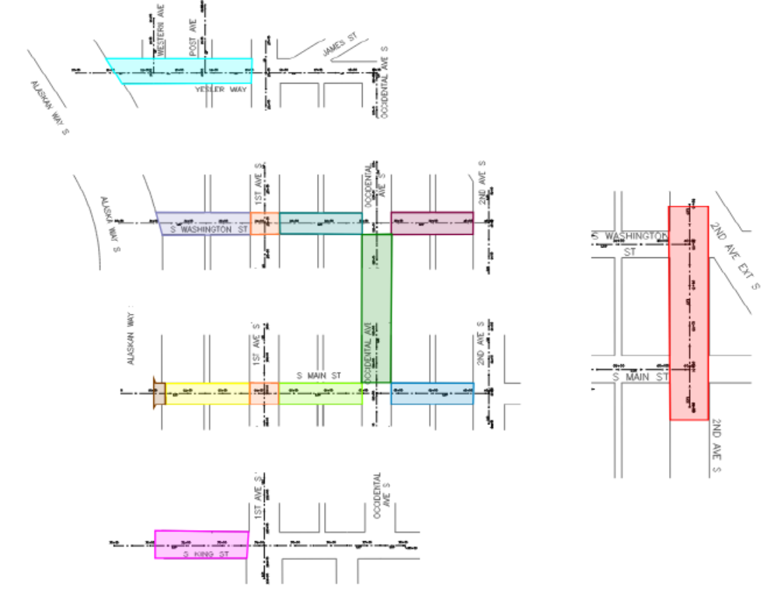
WORK ZONES
Notes:
We will be usually not be working on more than two zones at a time.

Slide 33
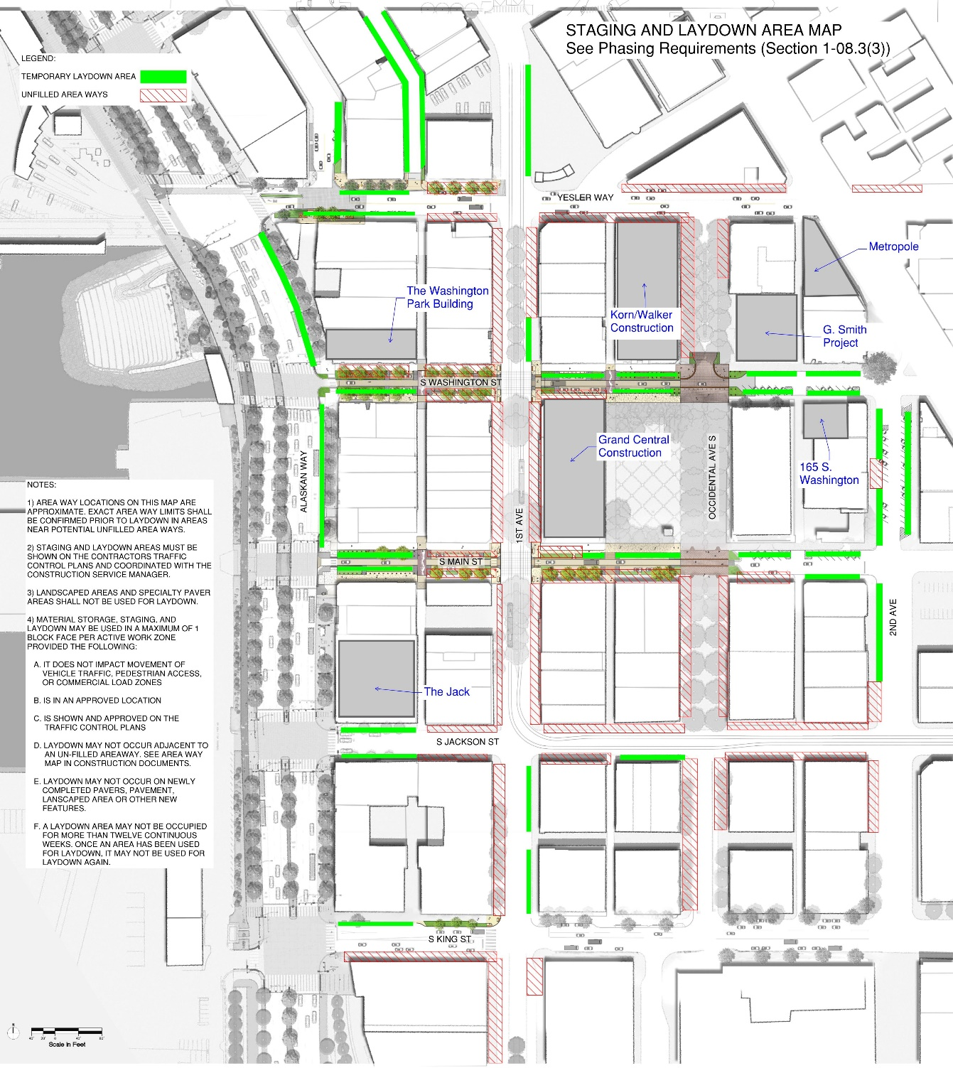
STAGING & LAYDOWN

Slide 34
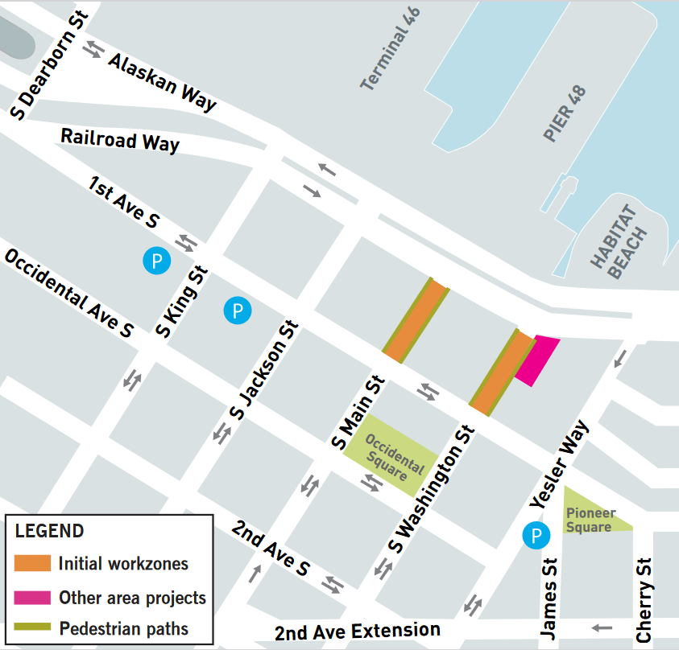
WHAT TO EXPECT
As early as Tuesday, January 2, we will begin on S Washington St. and/or S Main St. between Alaskan Way and 1st Ave
Work should take about 3.5 months each zone (15 weeks)
West of 1st Ave, thru traffic may be closed for up to 2.5 months (11 weeks)
One reopened to traffic, remaining work in these zones should last no more than one month
Notes:
We have given restrictions & rules for our contractor to follow during construction to provide the least inconvenience to neighbors

Slide 35
WHAT TO EXPECT: ACCESS
Pedestrian access will be maintained at all times.
Business access will be maintained at all times.
Alleys will be accessible from one end at all times.
Work hours typically Monday through Friday, 7 AM to 5 PM
Commercial loading zones impacted by construction will be relocated temporarily.

Slide 36
Construction hotline Our construction hotline is staffed anytime we have active work – don’t hesitate call or text us if you notice issues or have questions! 206.499.8040

Slide 37
UPCOMING OUTREACH
Prior to work starting on each zone, we will be:
attending community events (come see us at the Holiday Market on Friday, Dec. 8 – Saturday, Dec. 9!),
sending out mailers and flyering,
and reaching out to neighbors via phone and email to coordinate any access needs.

Slide 38
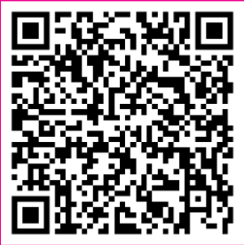
ONGOING OUTREACH
Fill out our contact form to make sure we have the latest contact information for you to receive time-sensitive notifications:
We will also include PSQ updates in the weekly Waterfront construction emails. You can sign up through the QR code above!

Slide 39
QUESTIONS?
Please send in your questions using the chat or use the raise hand function to be unmuted.
Notes:
Thank you for taking the time to learn more about Pioneer Square East-West Connections today! Please feel free to share any questions or comments with us via the email and phone number shown on this slide. Stay tuned for additional engagement opportunities by signing up for our program emails at www.waterfrontseattle.org.

Slide 40
QUESTIONS?
Contact us at:
info@waterfrontseattle.org
206.499.8040
waterfrontseattle.org
Notes:
Thank you for taking the time to learn more about Pioneer Square East-West Connections today! Please feel free to share any questions or comments with us via the email and phone number shown on this slide. Stay tuned for additional engagement opportunities by signing up for our program emails at www.waterfrontseattle.org.

